Slide 1
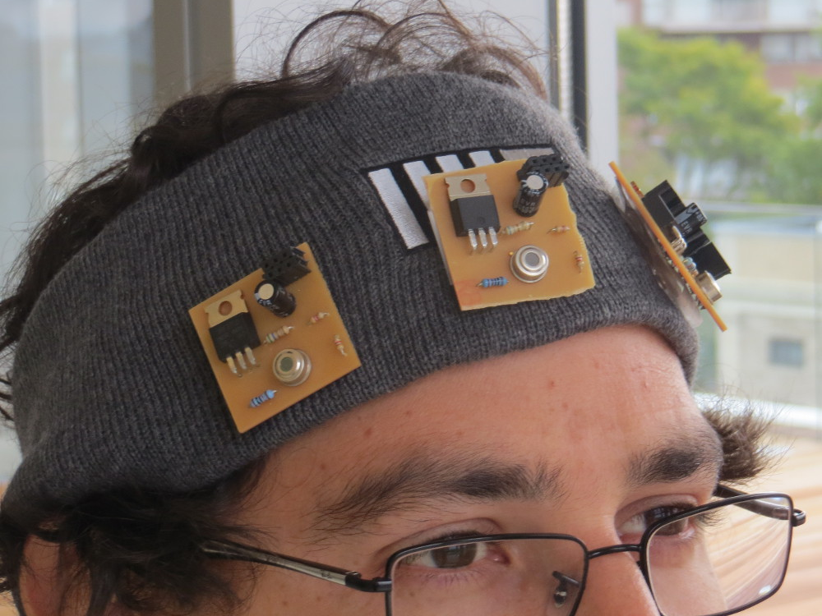
Digital synesthesia
Using Mobile Technology to Interact with Our World
PhD Proposal By:
Santiago Alfaro
Committee:
V. Michael Bove Jr.
Joseph Paradiso
Kevin Slavin

Slide 2
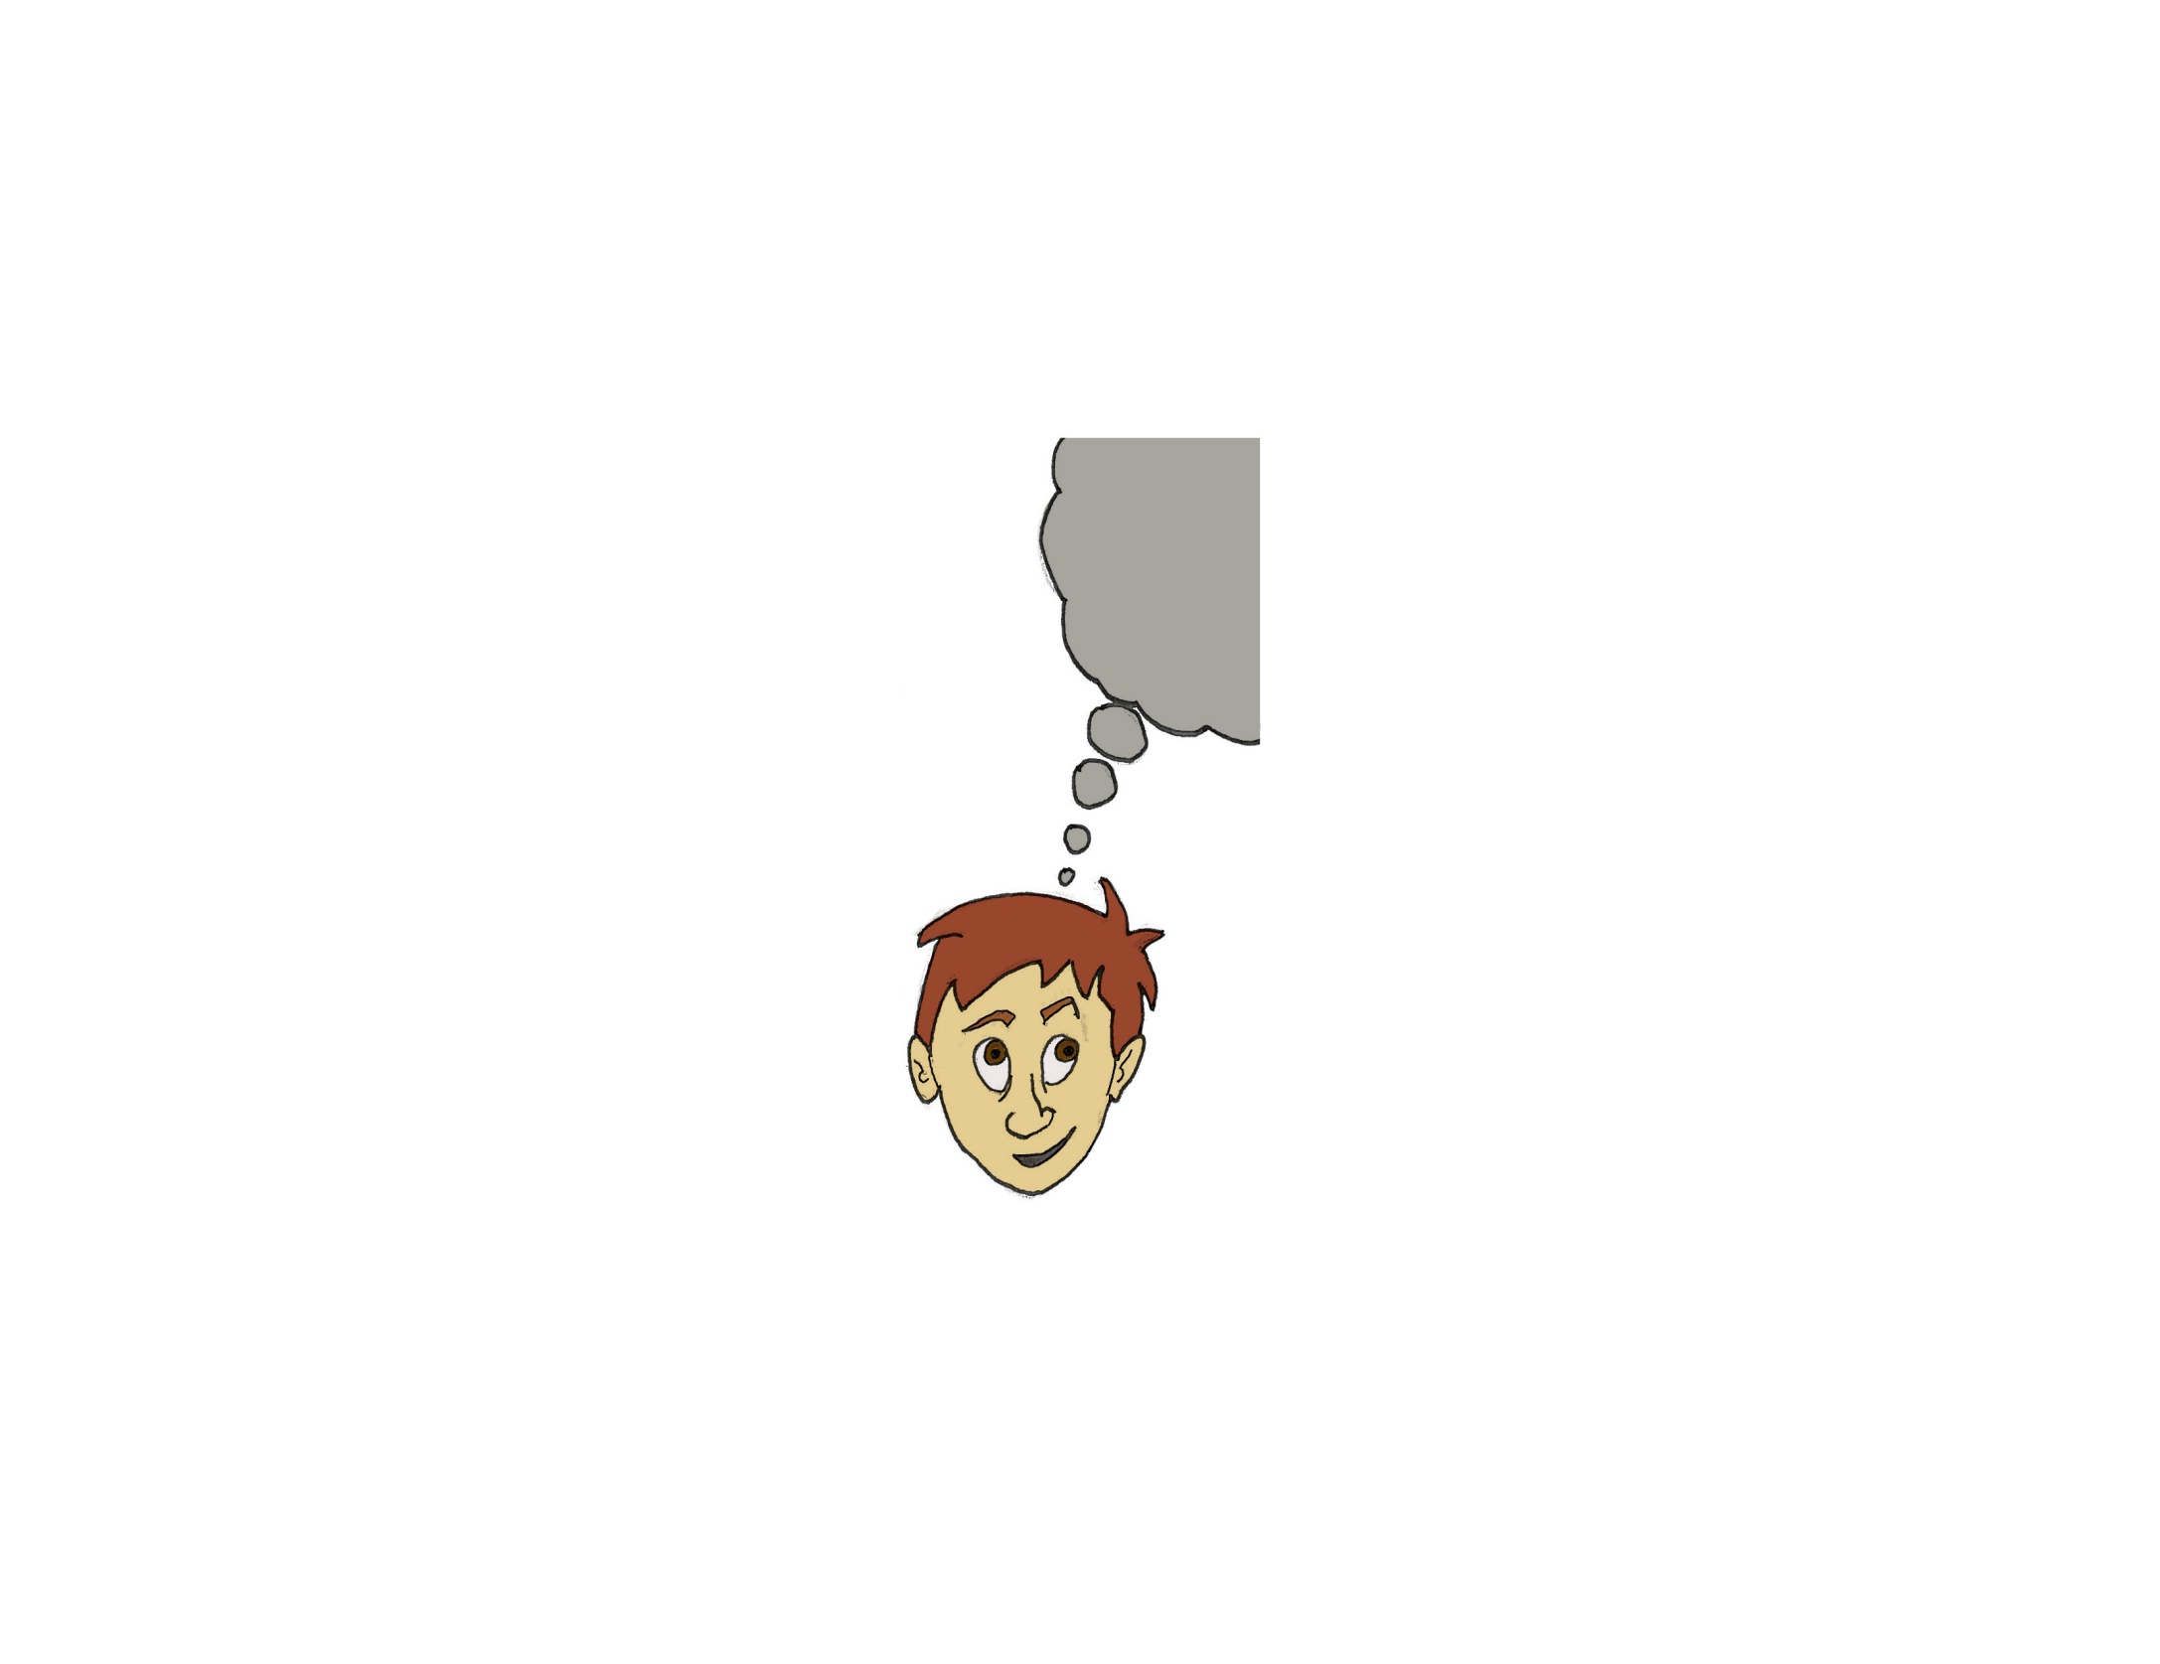
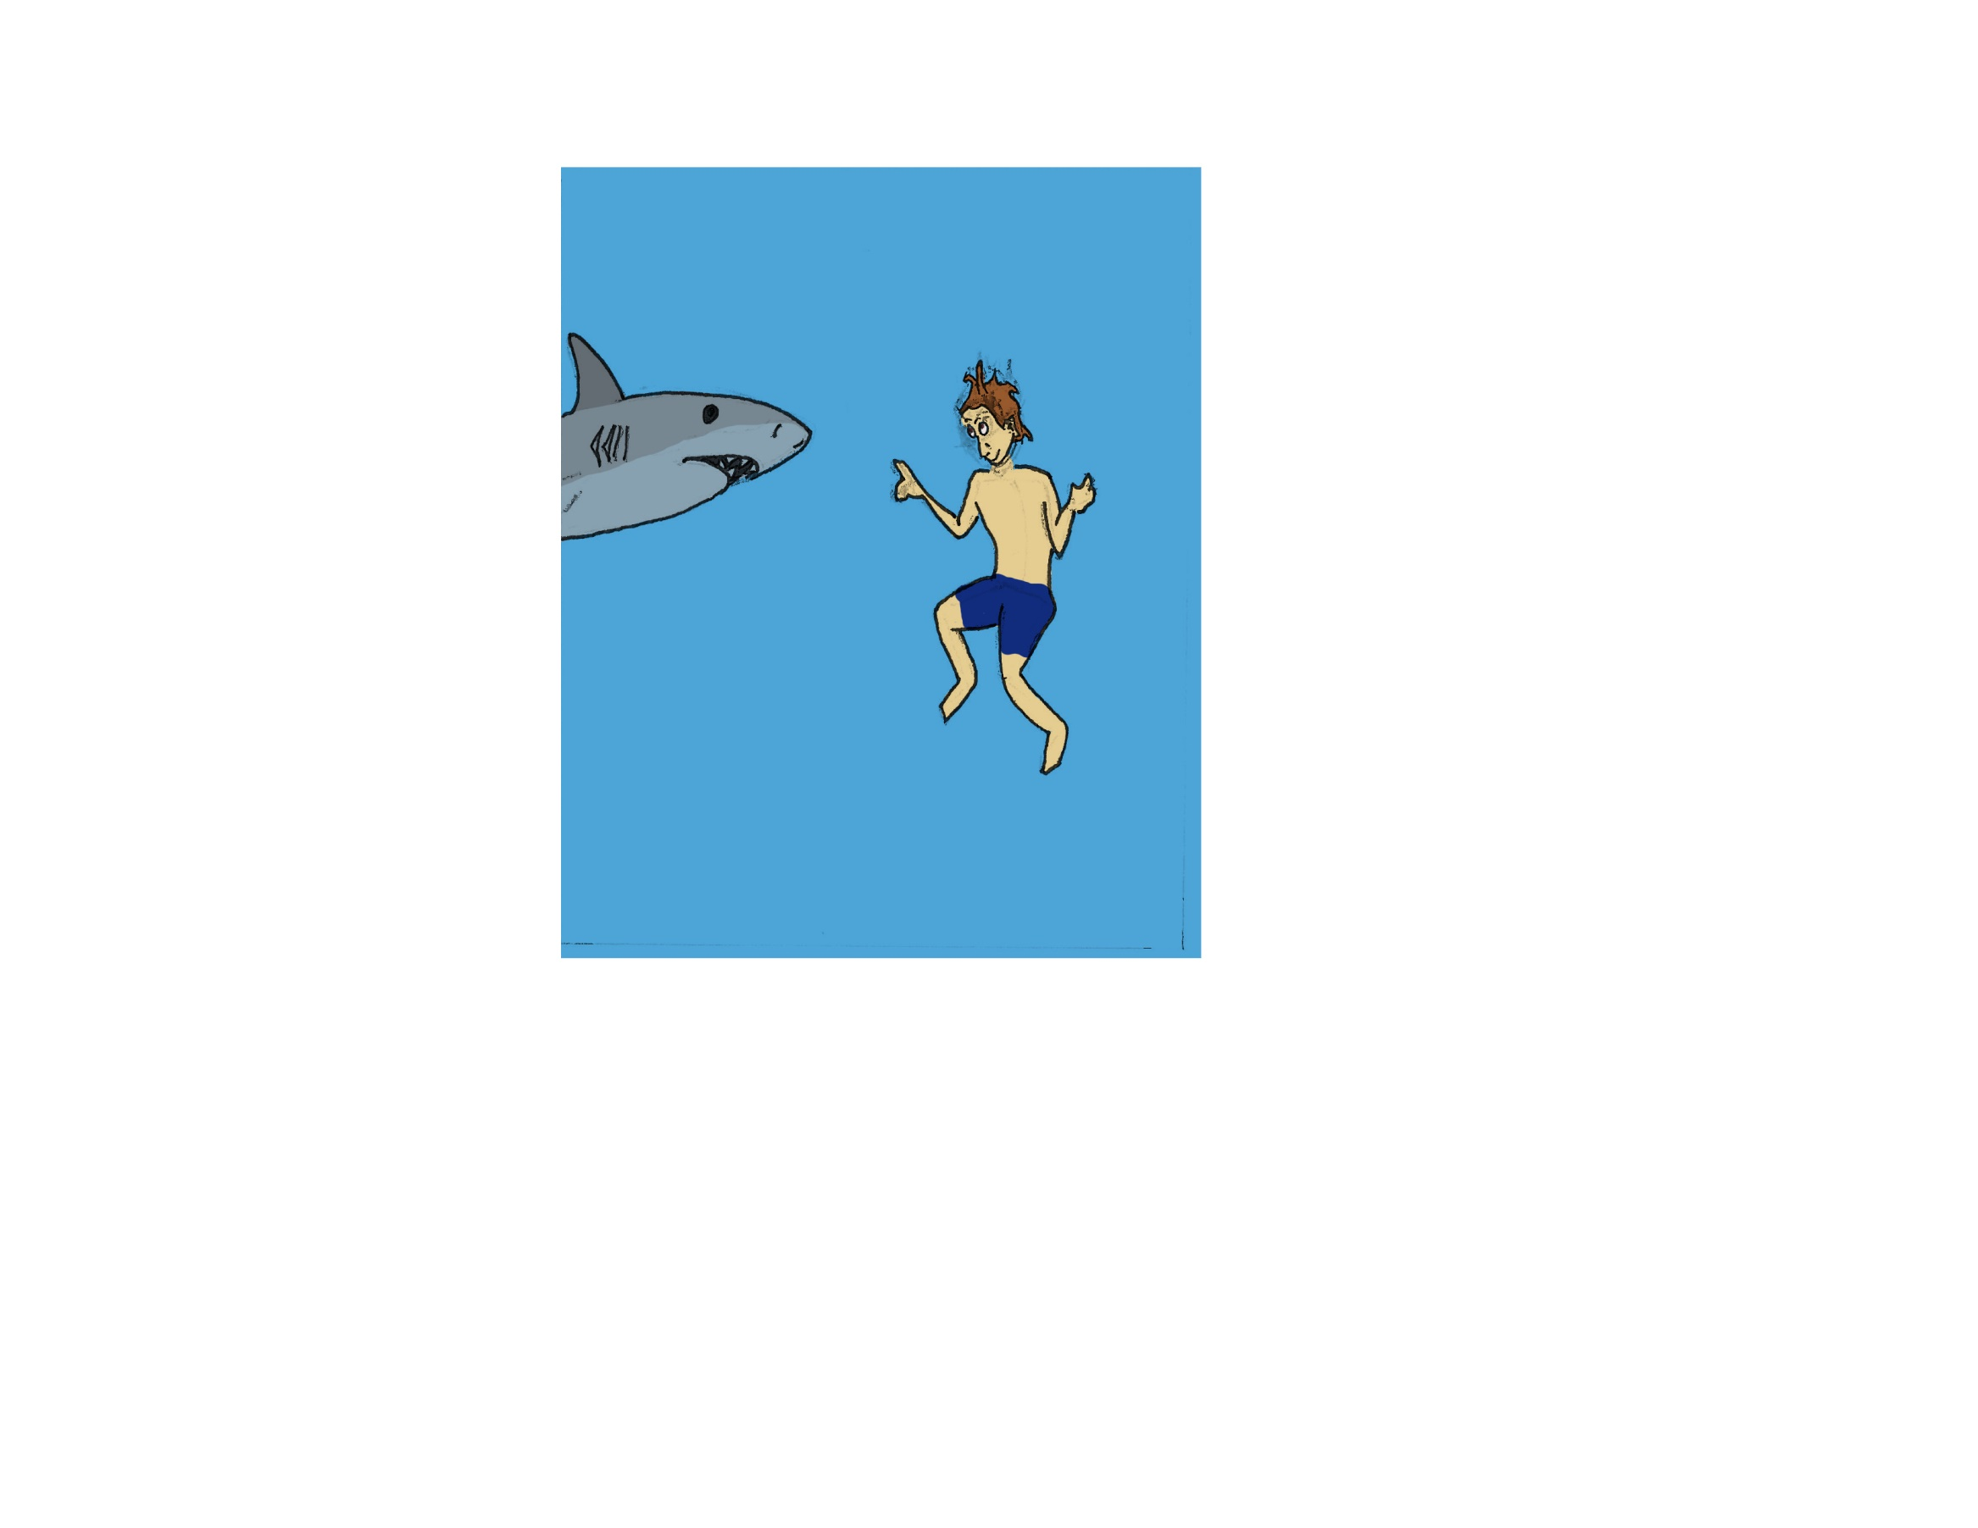
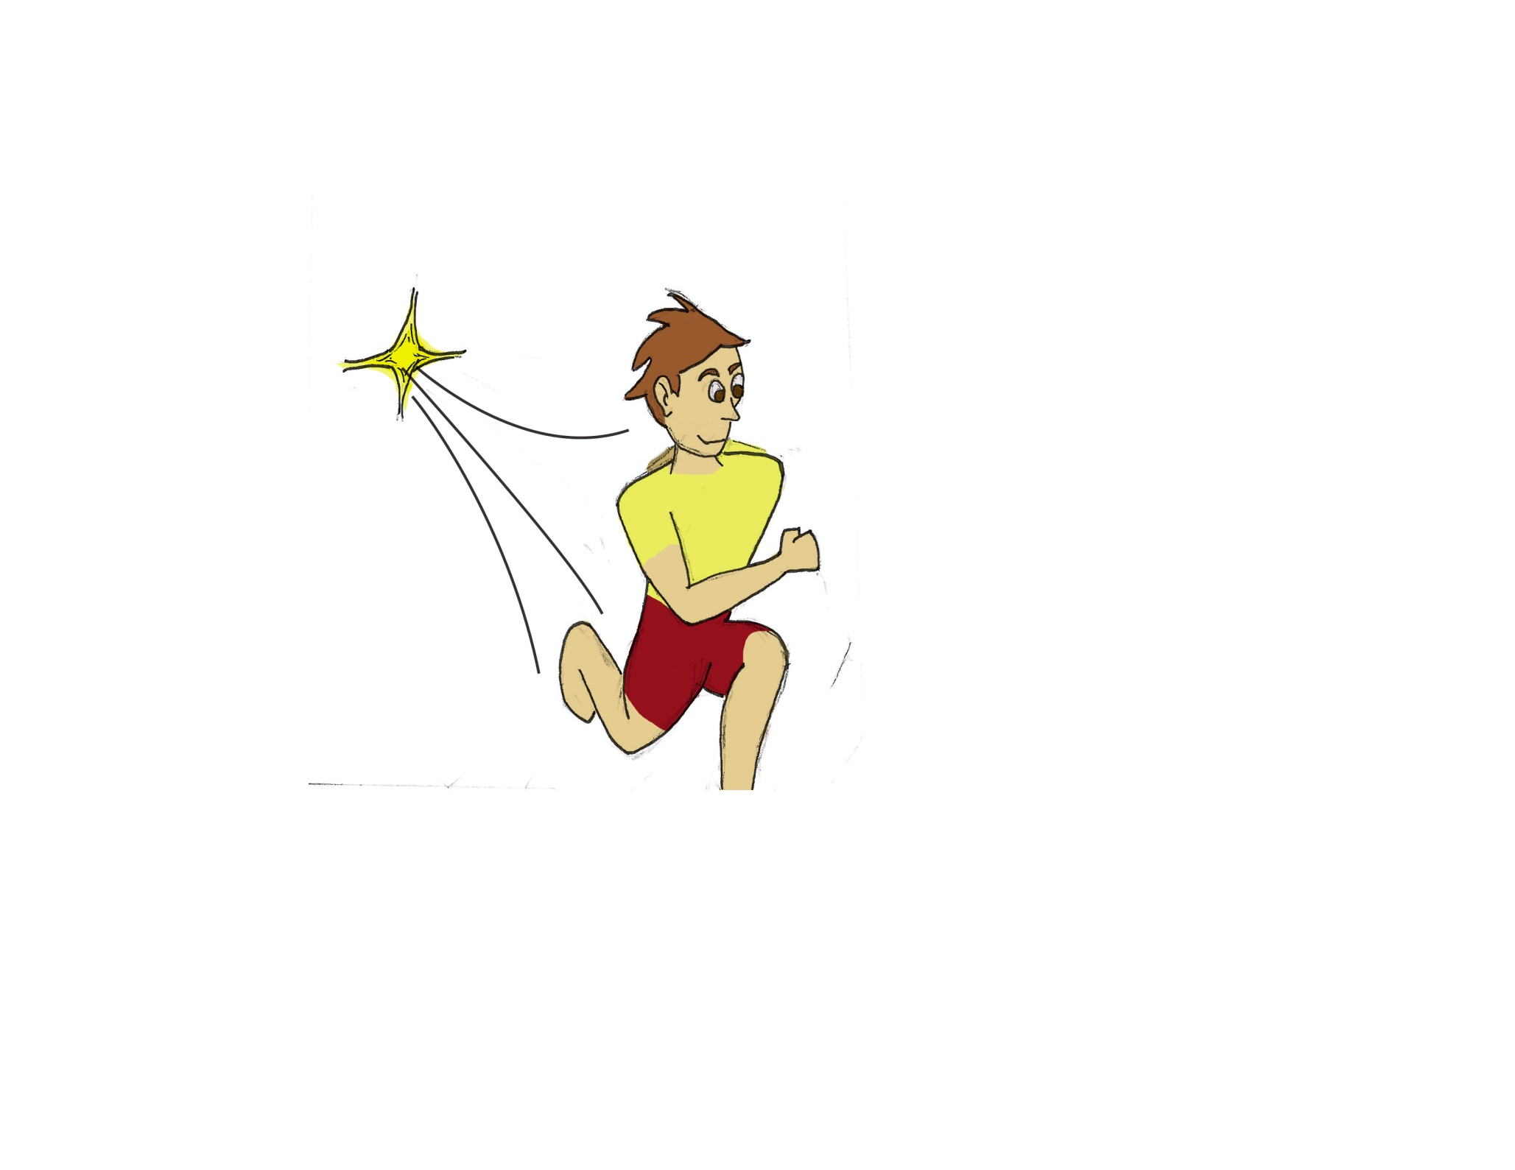
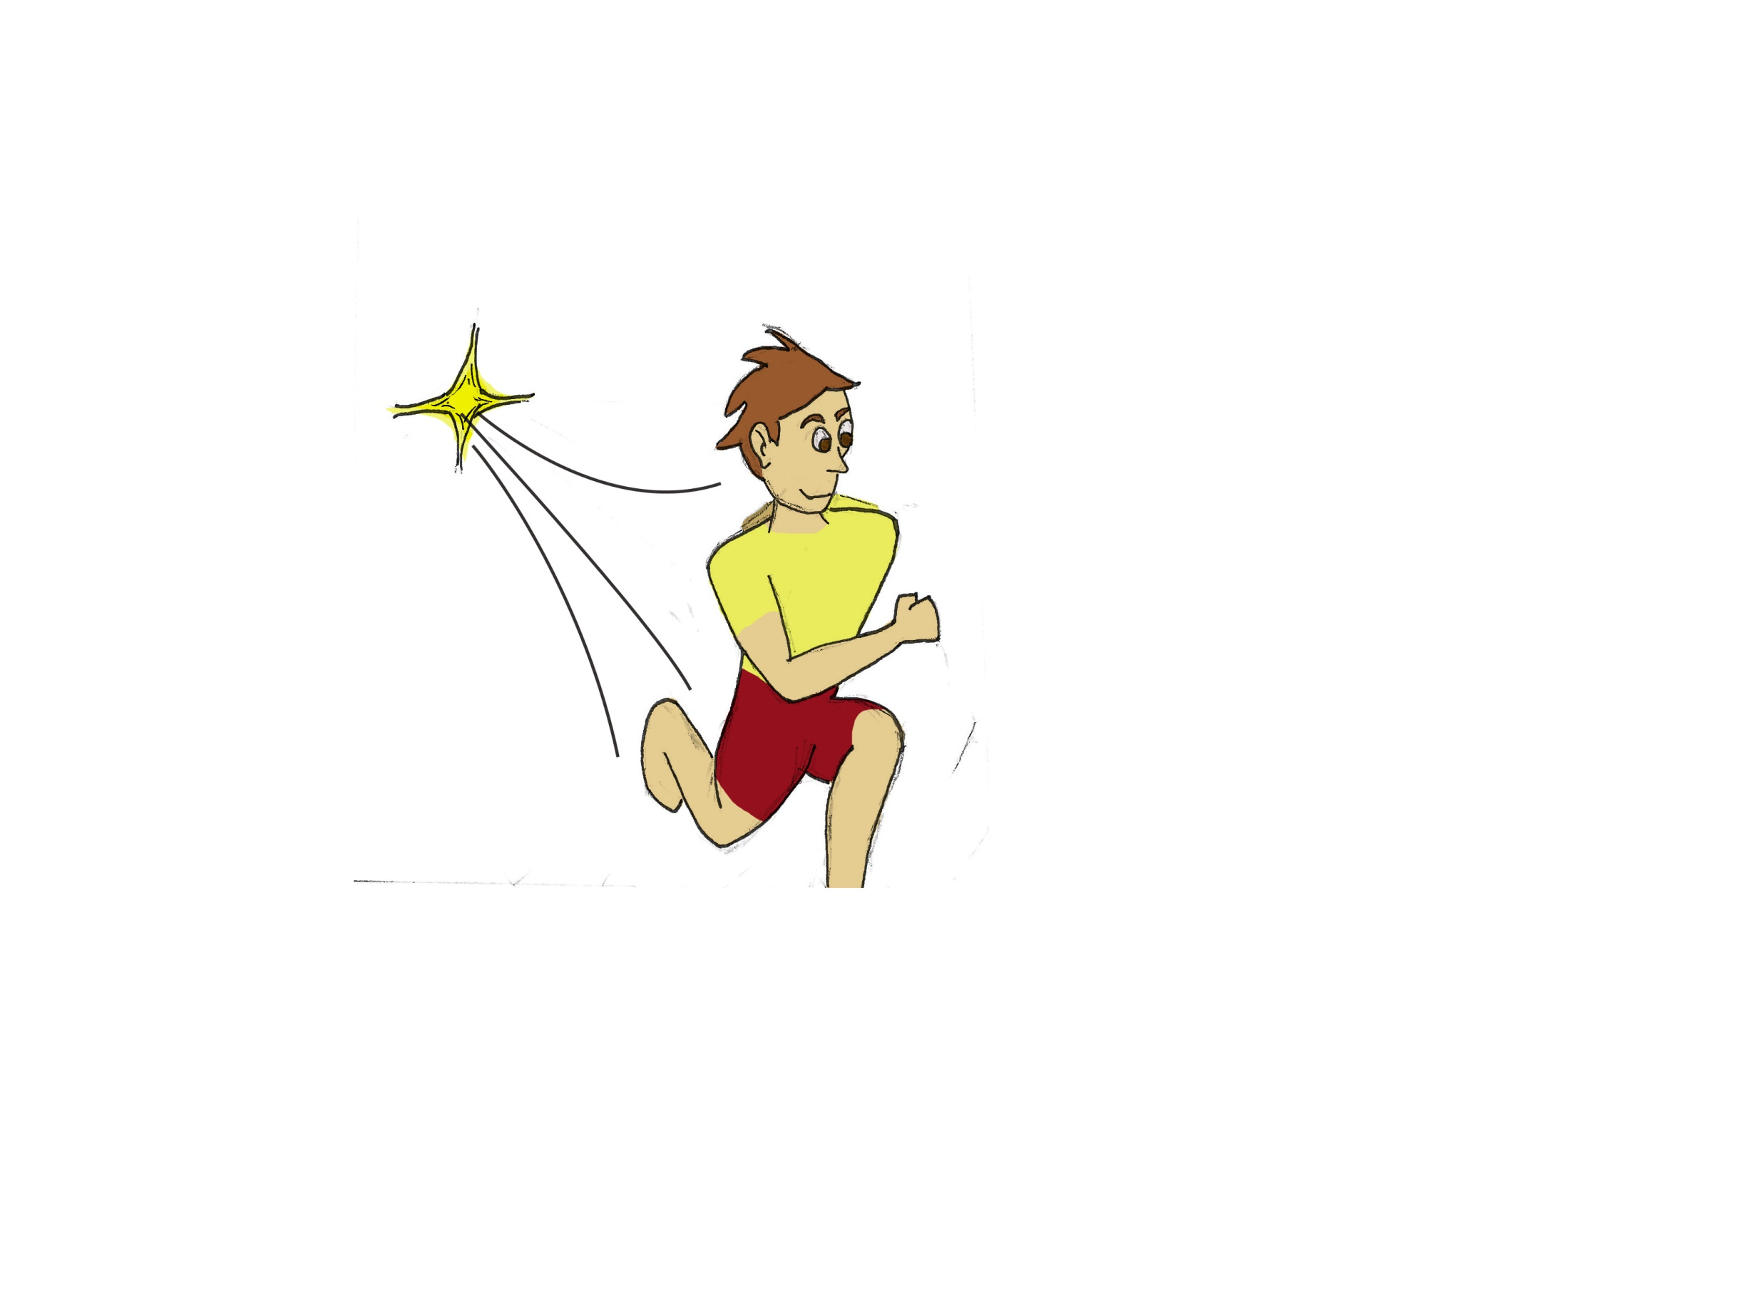
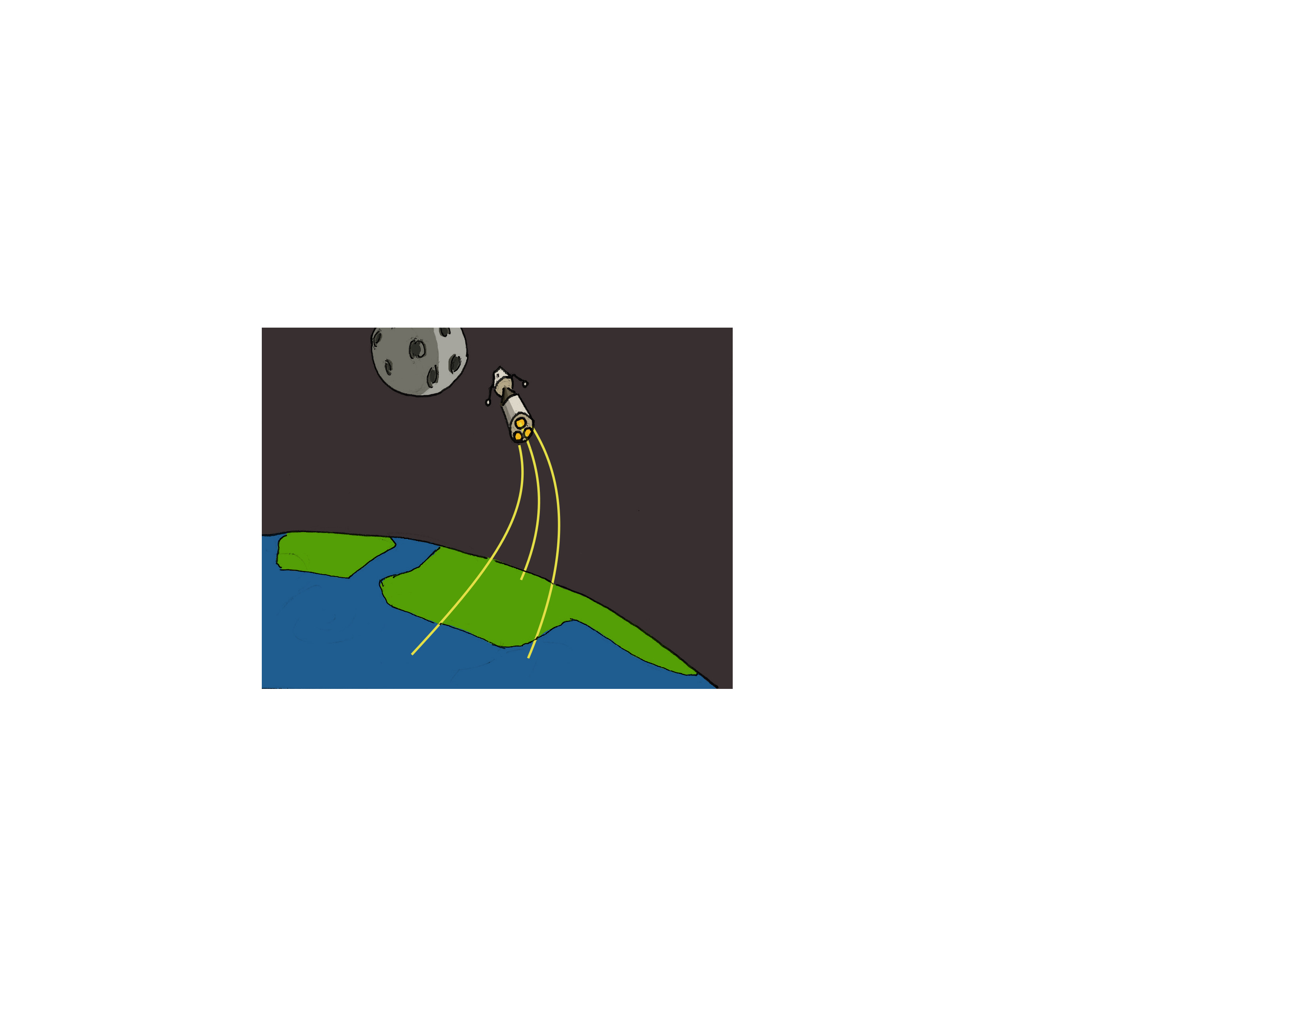

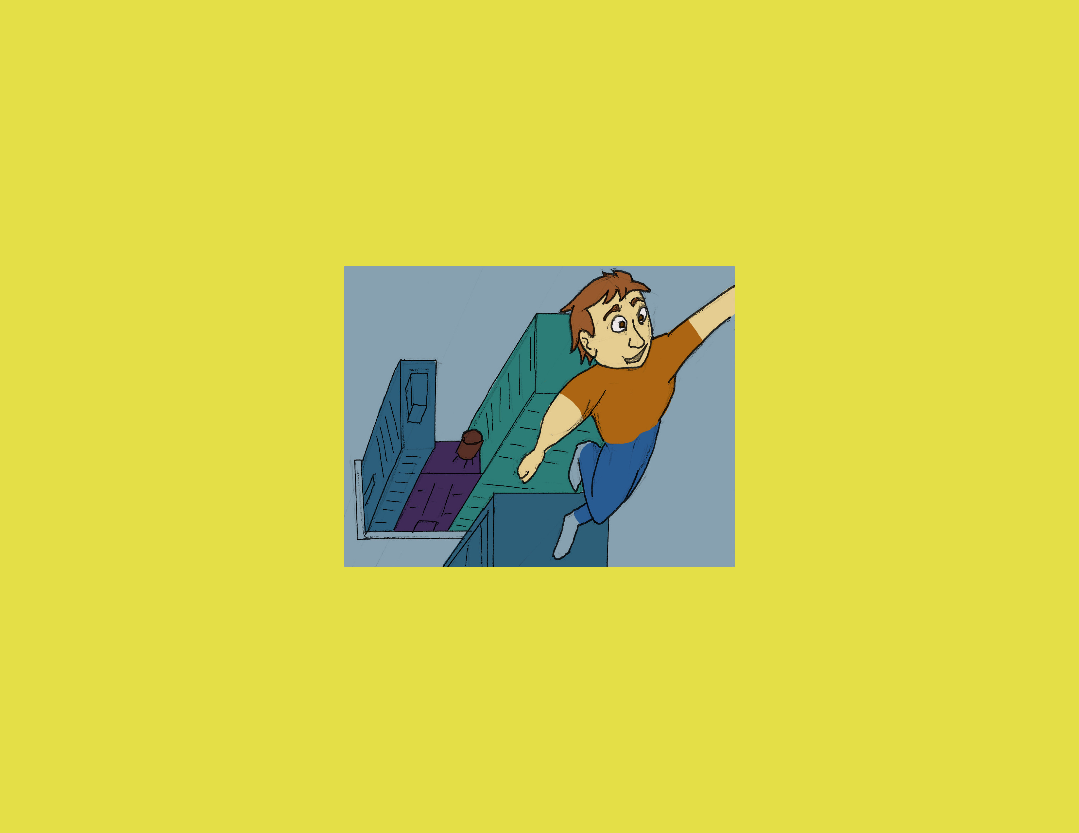
Humans have dreamt of going past our physical capabilities like…
… Breathing under water…
… Speed…
… or flying.
… going to space…
Notes:
Intro: Dreams:
Dreams - breathing under water – speed – space – flying.

Slide 3
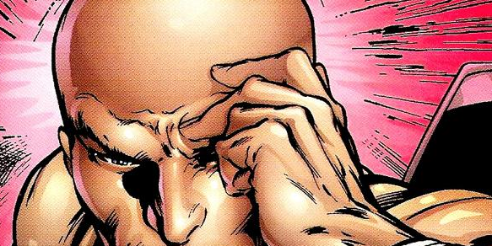
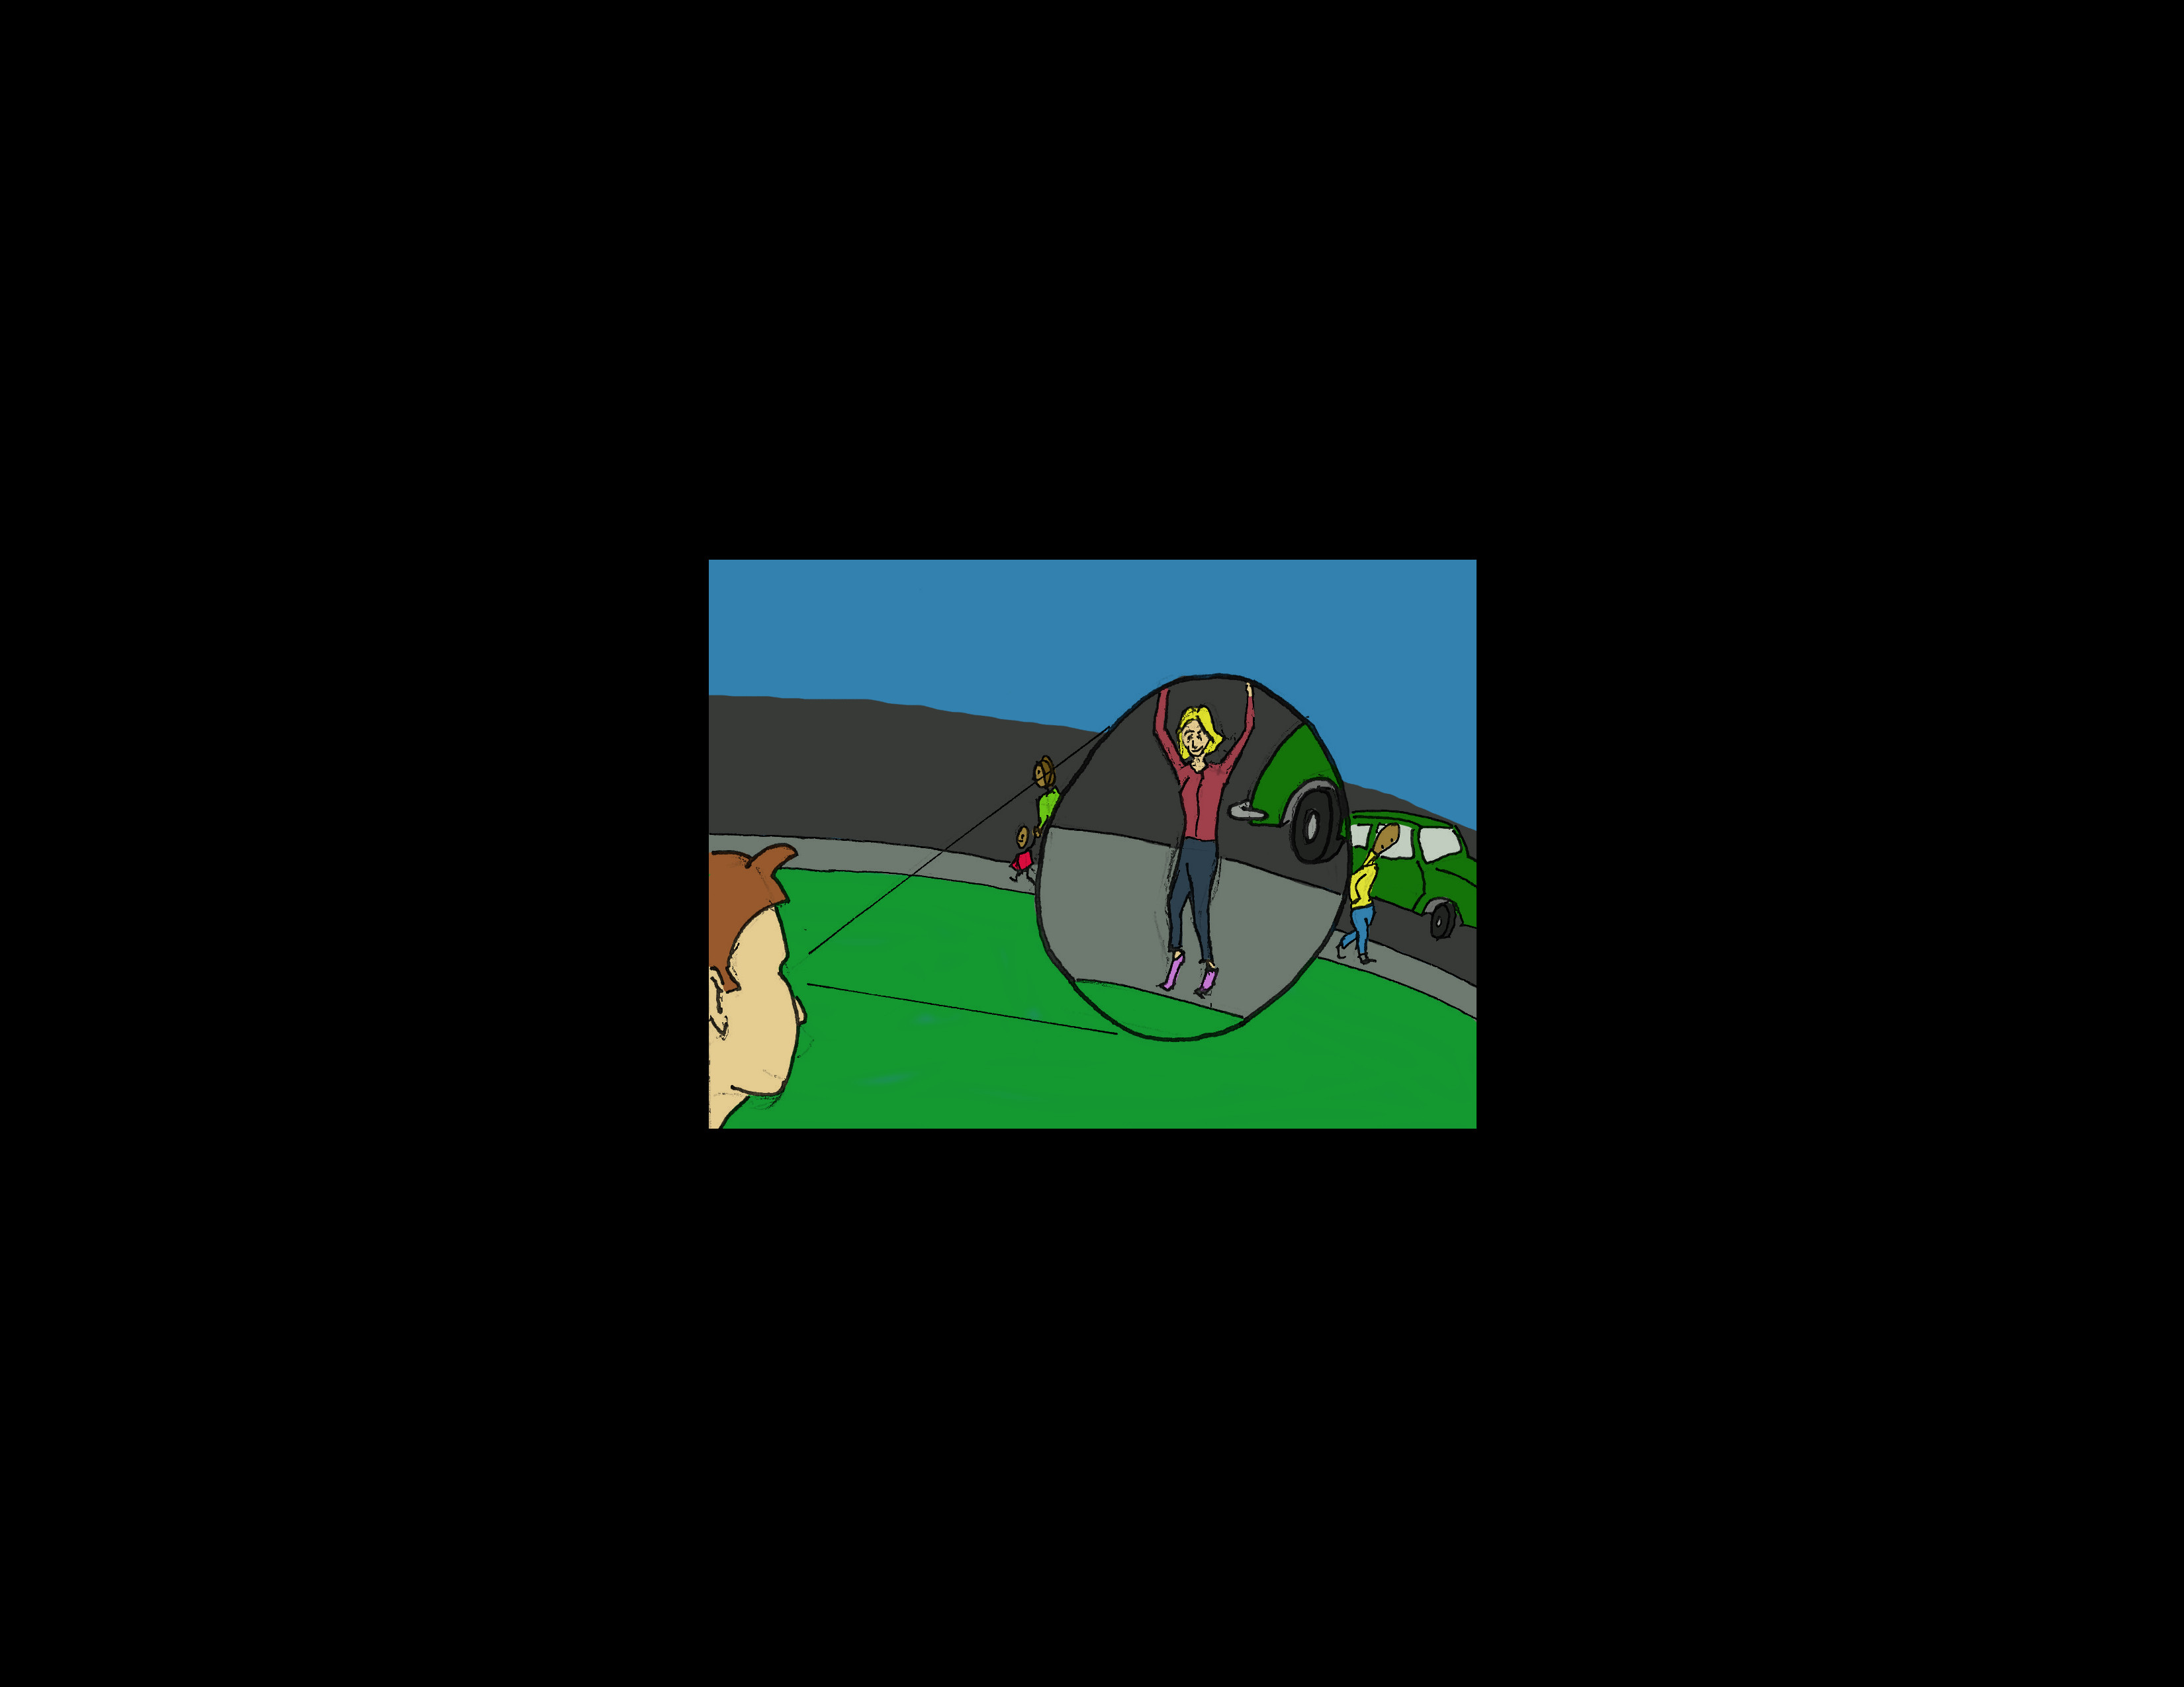
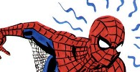
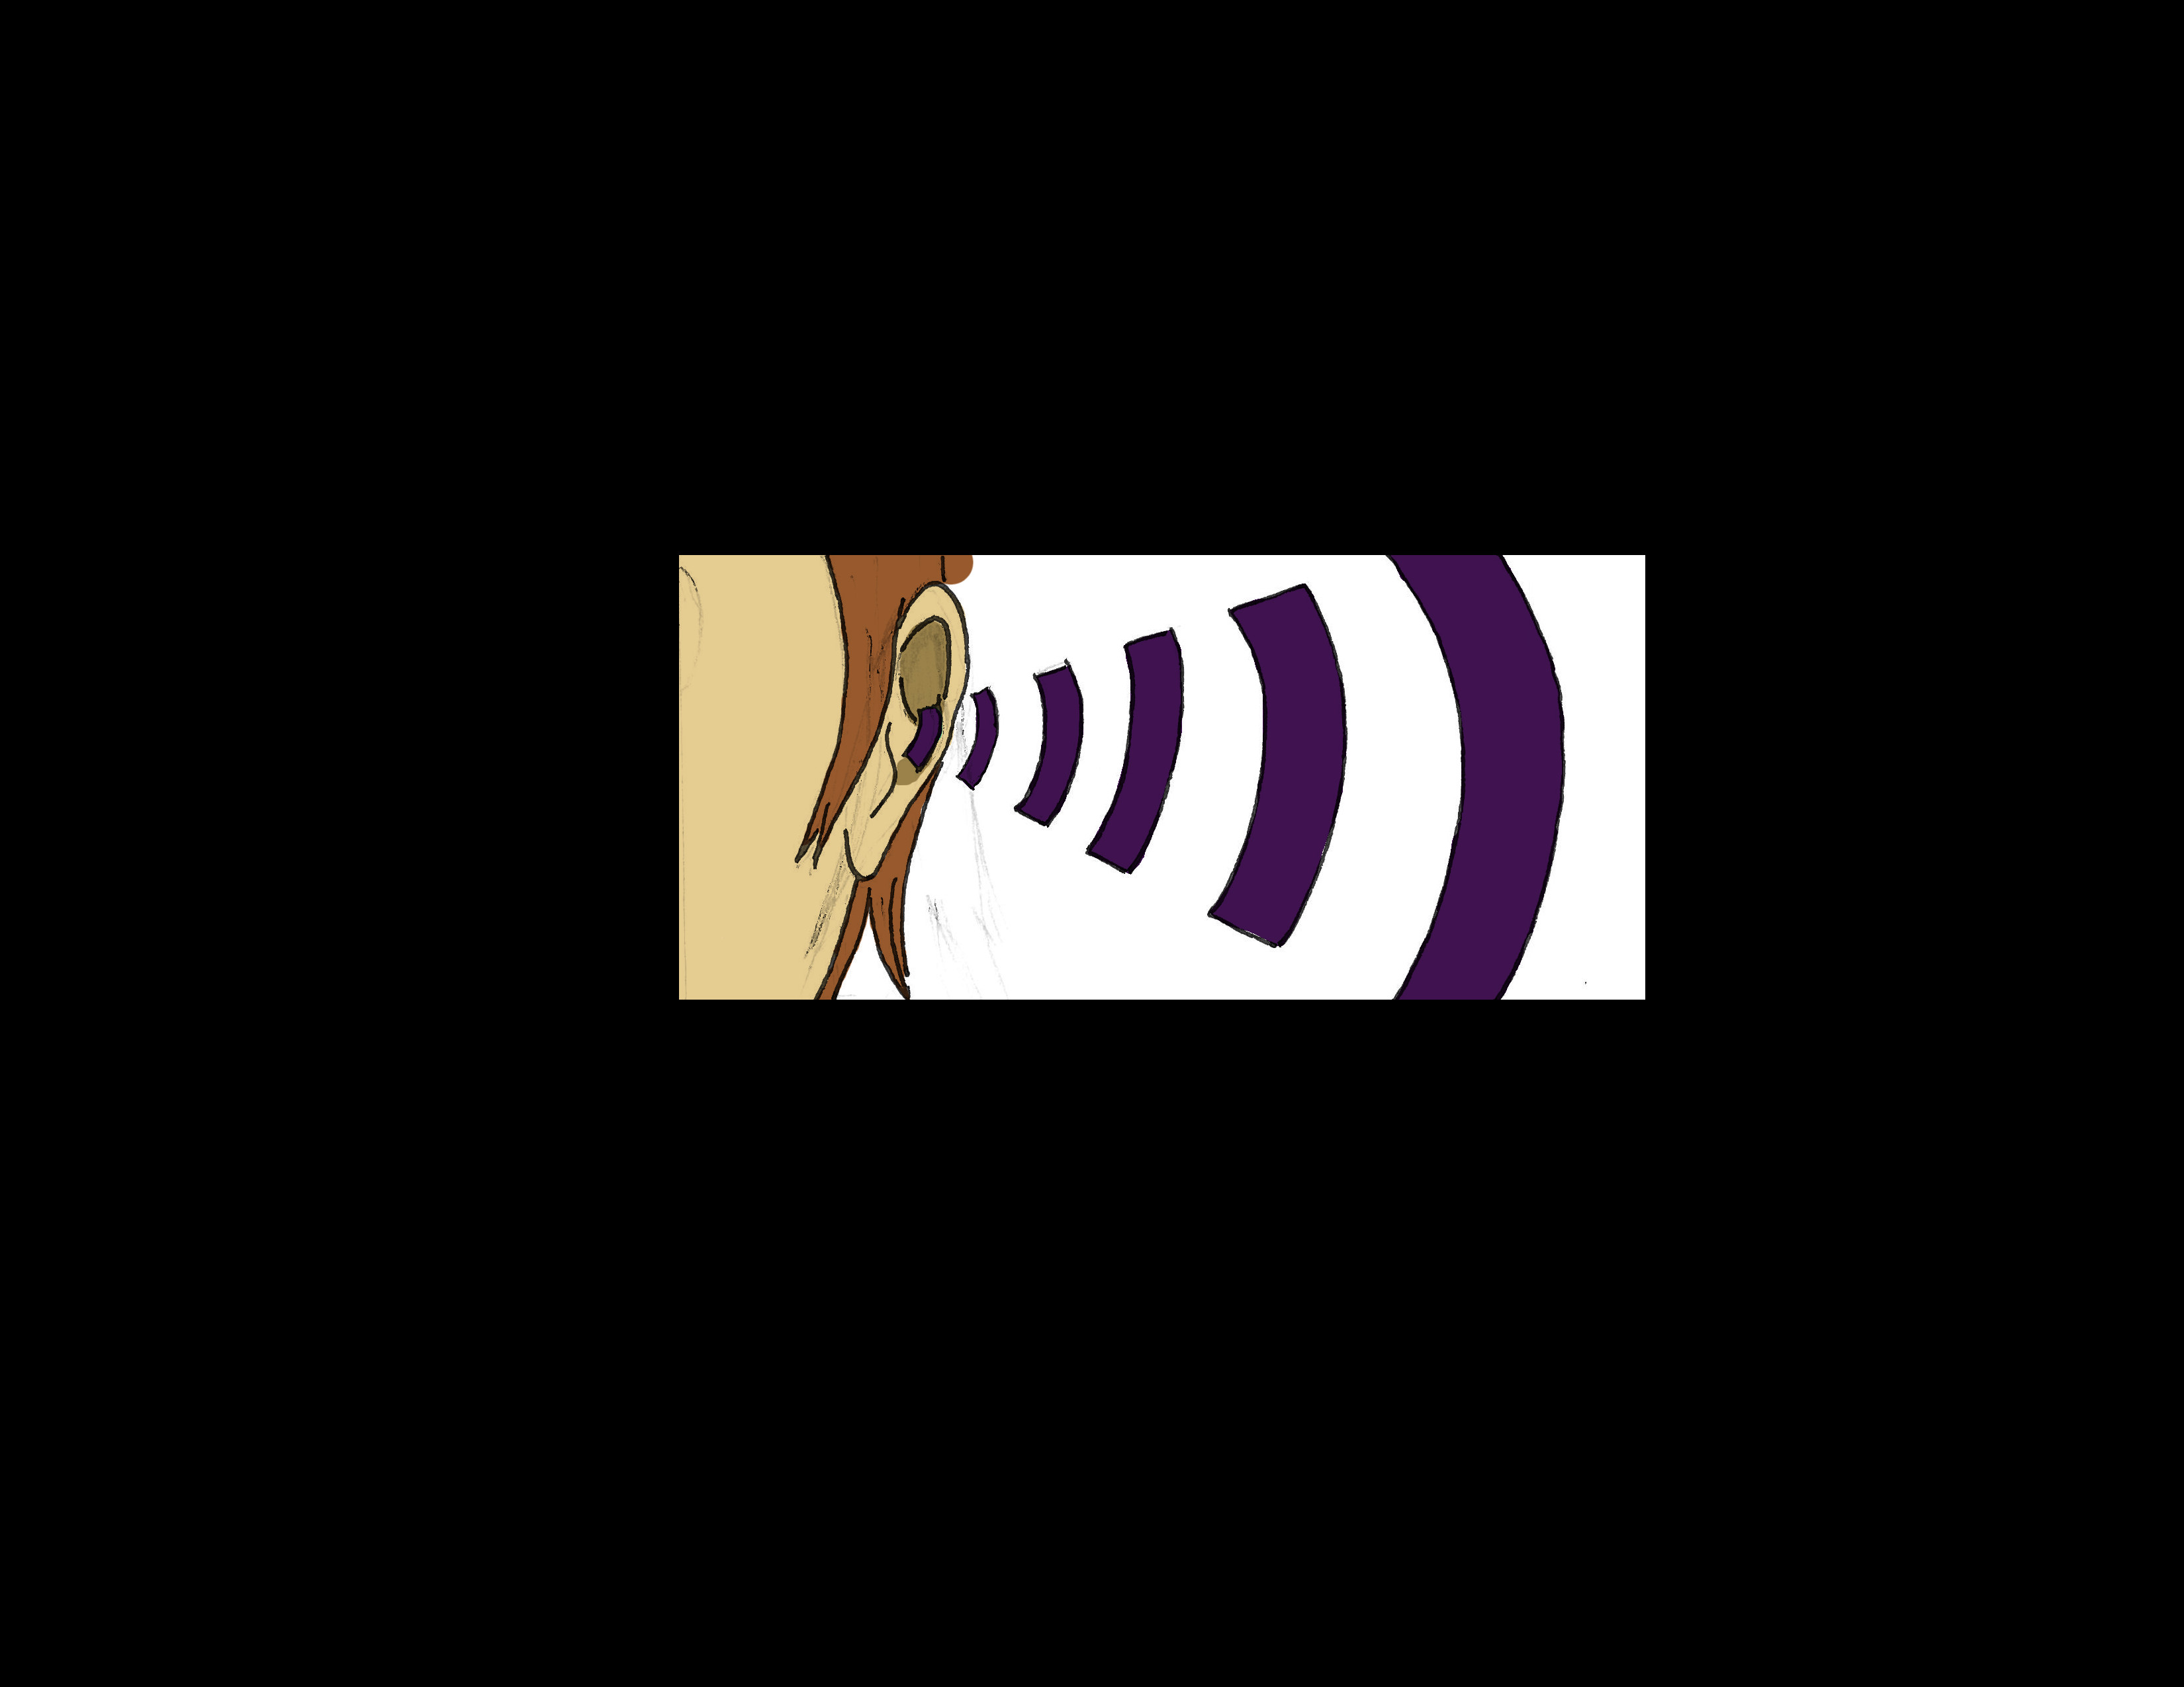
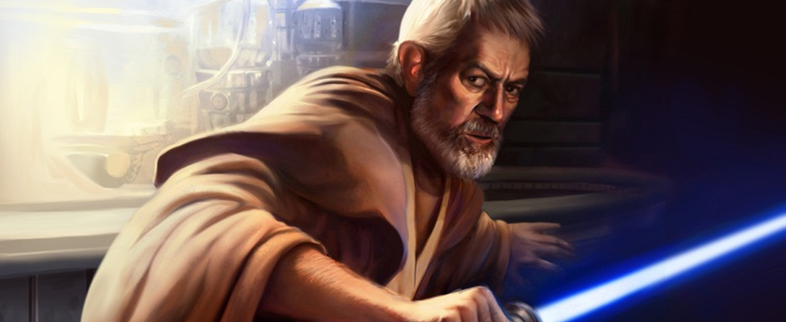
Other dreams are about our senses…
Some are about senses we don’t possess
… sight…
… spidey sense…
… hearing…
… a disturbance in the force.
Notes:
Intro: Super Heroes
Senses – Sight – sound – porf X – Spidey - Quickening

Slide 4
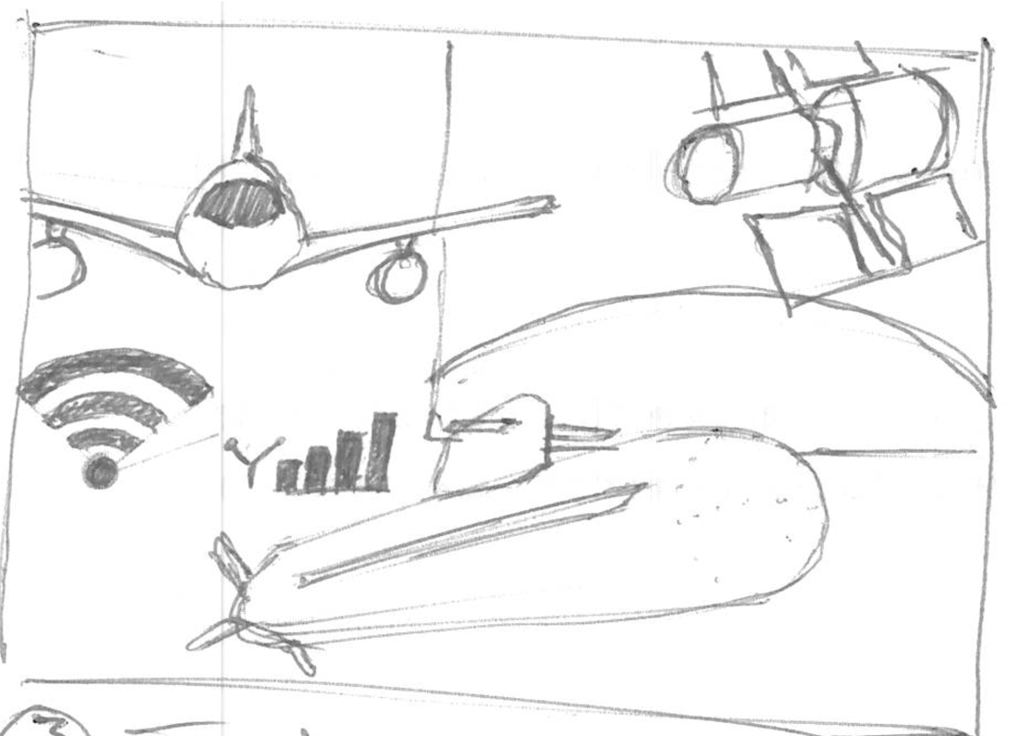
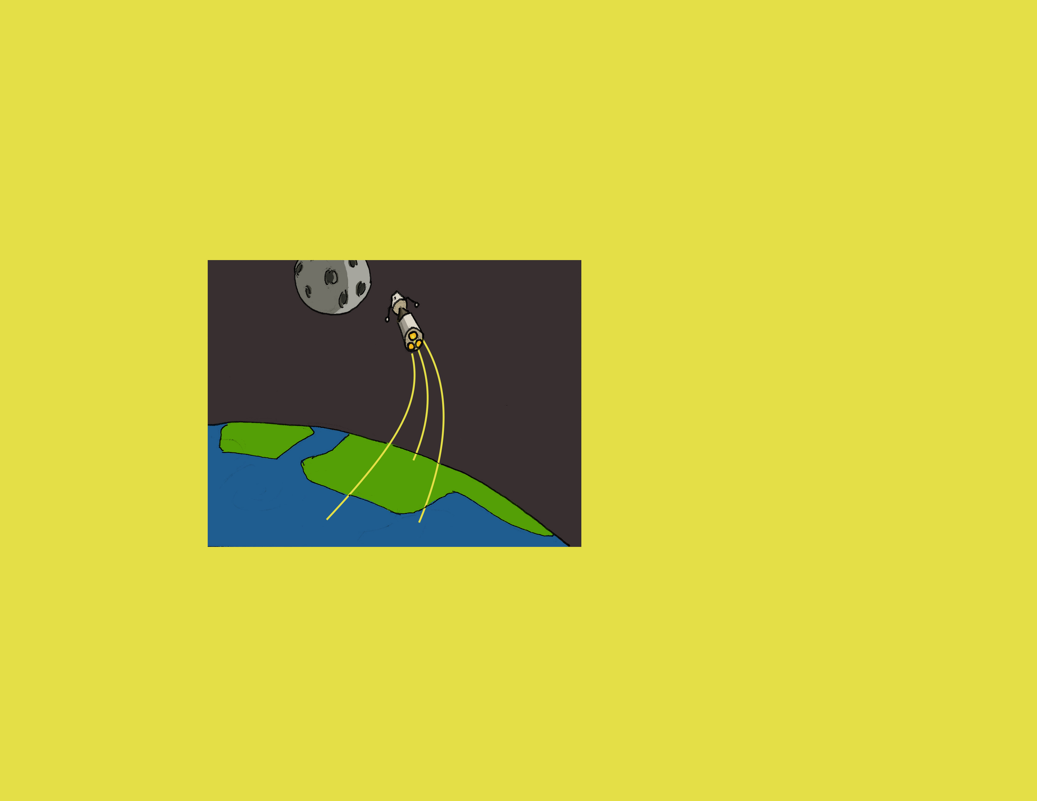

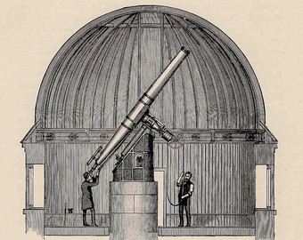
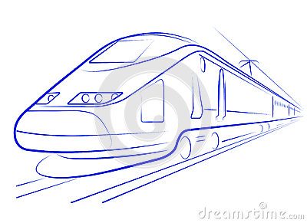
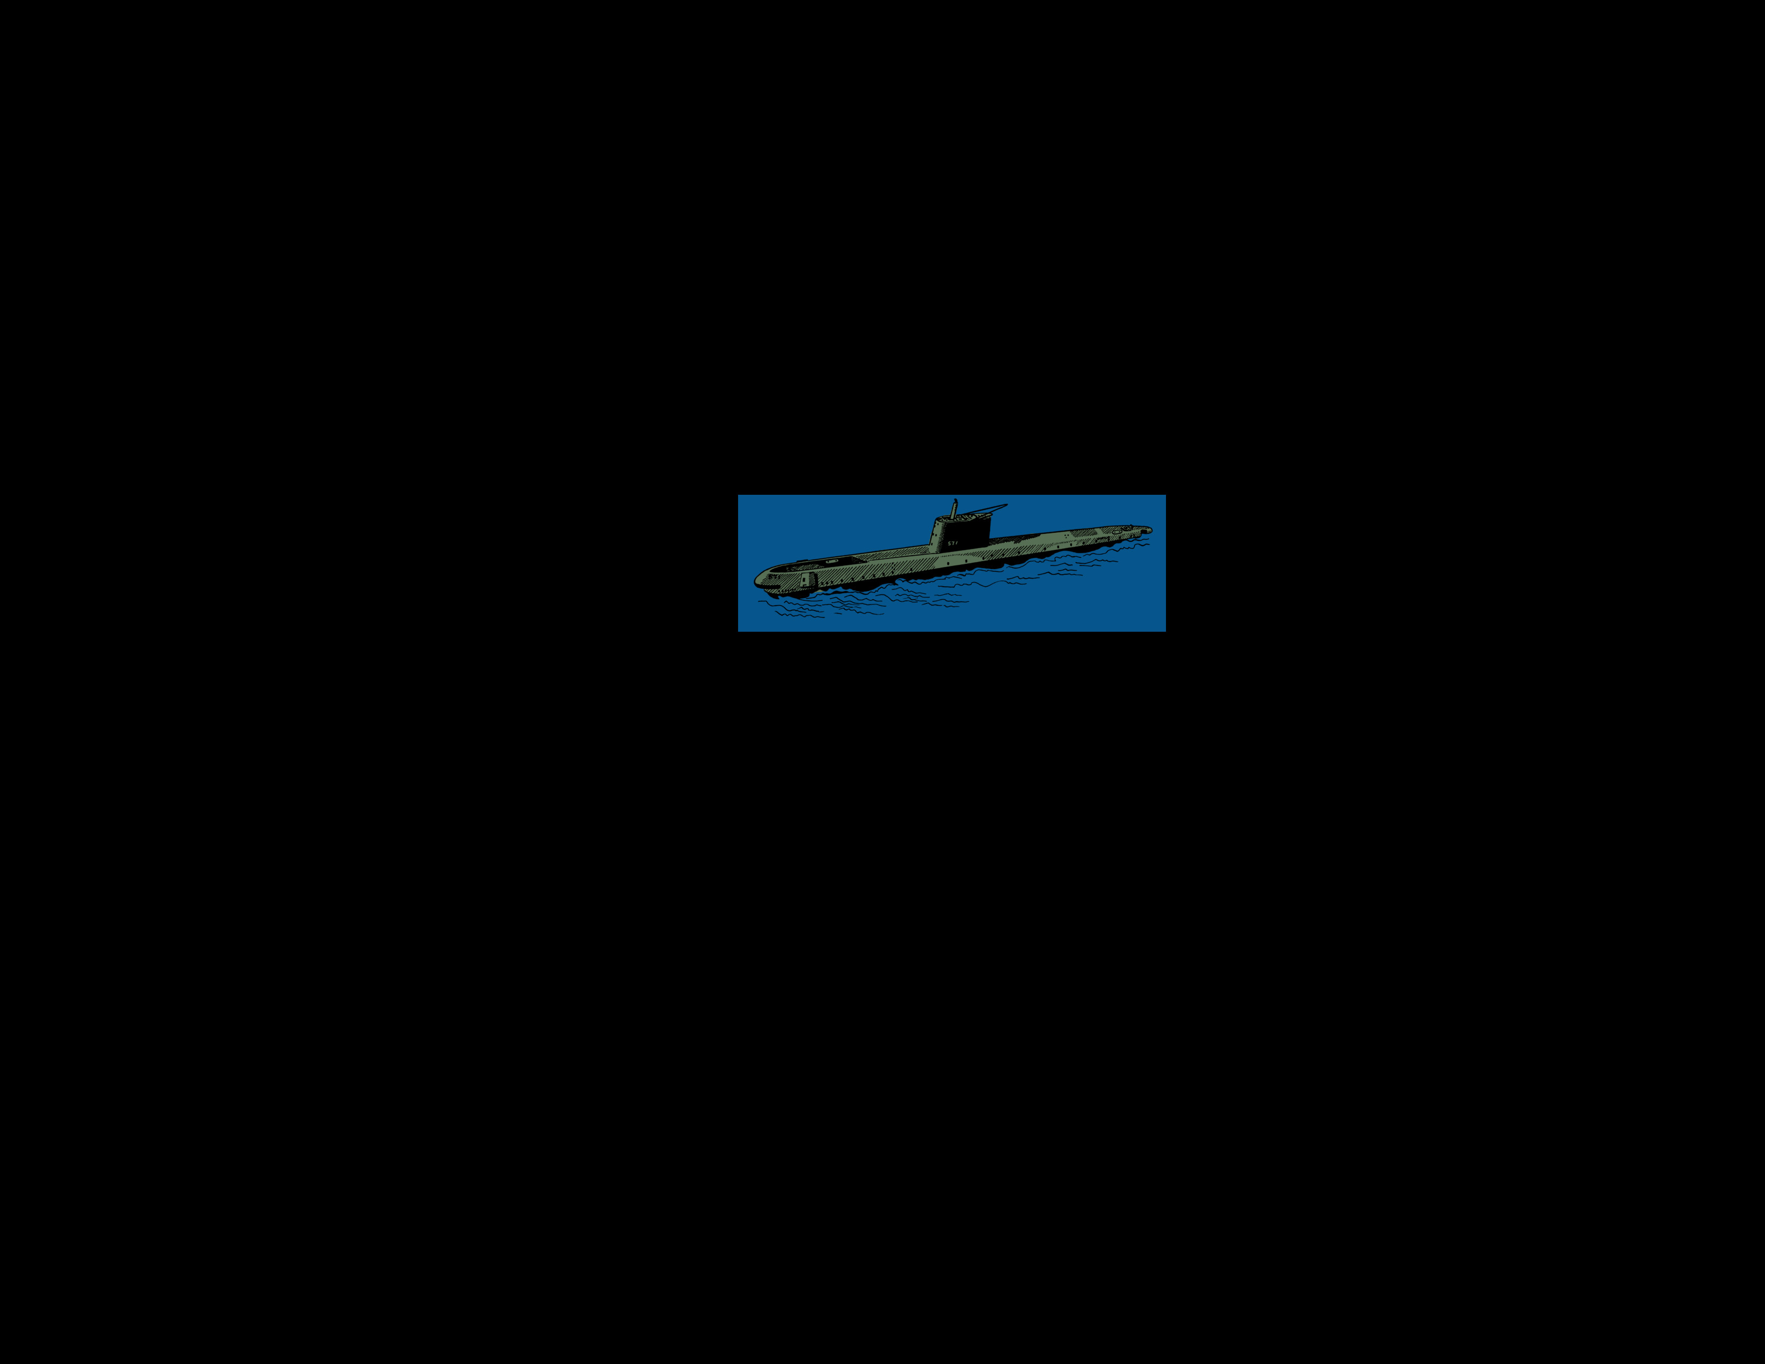

WE have reached some dreams
AND UNDERSTANDING OUR WORLD
With technology
Notes:
Intro: Technology

Slide 5
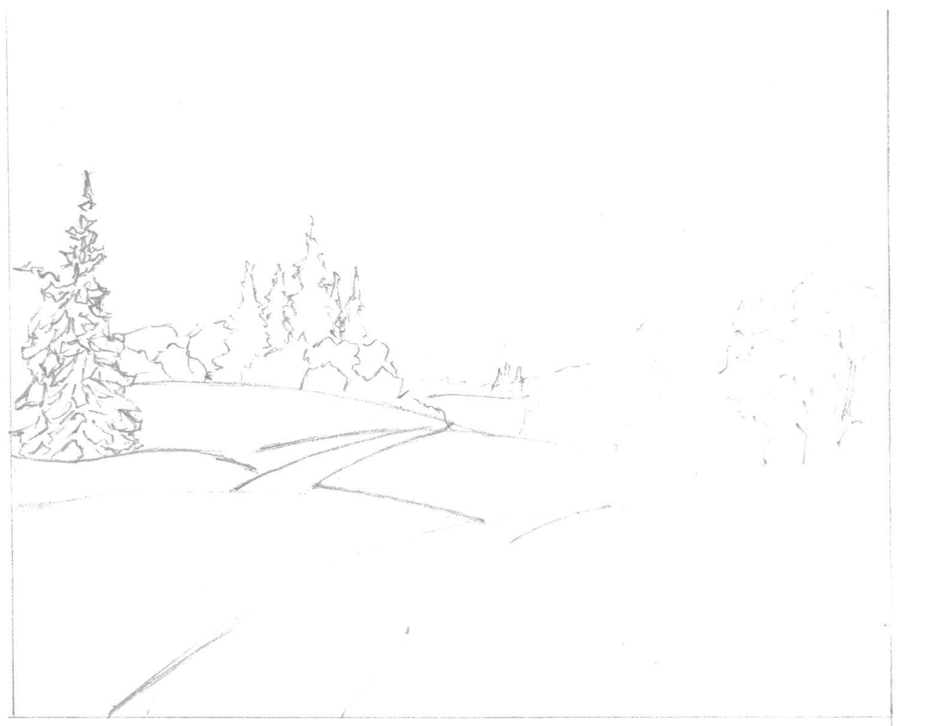
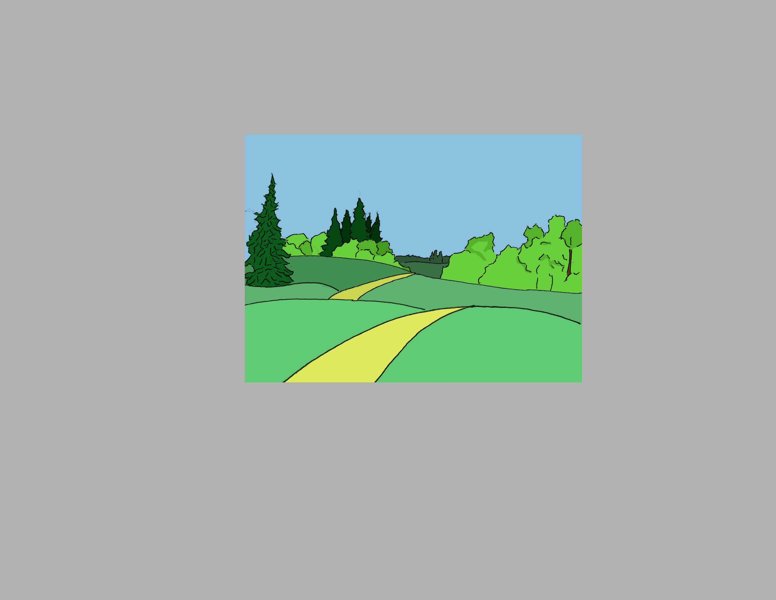
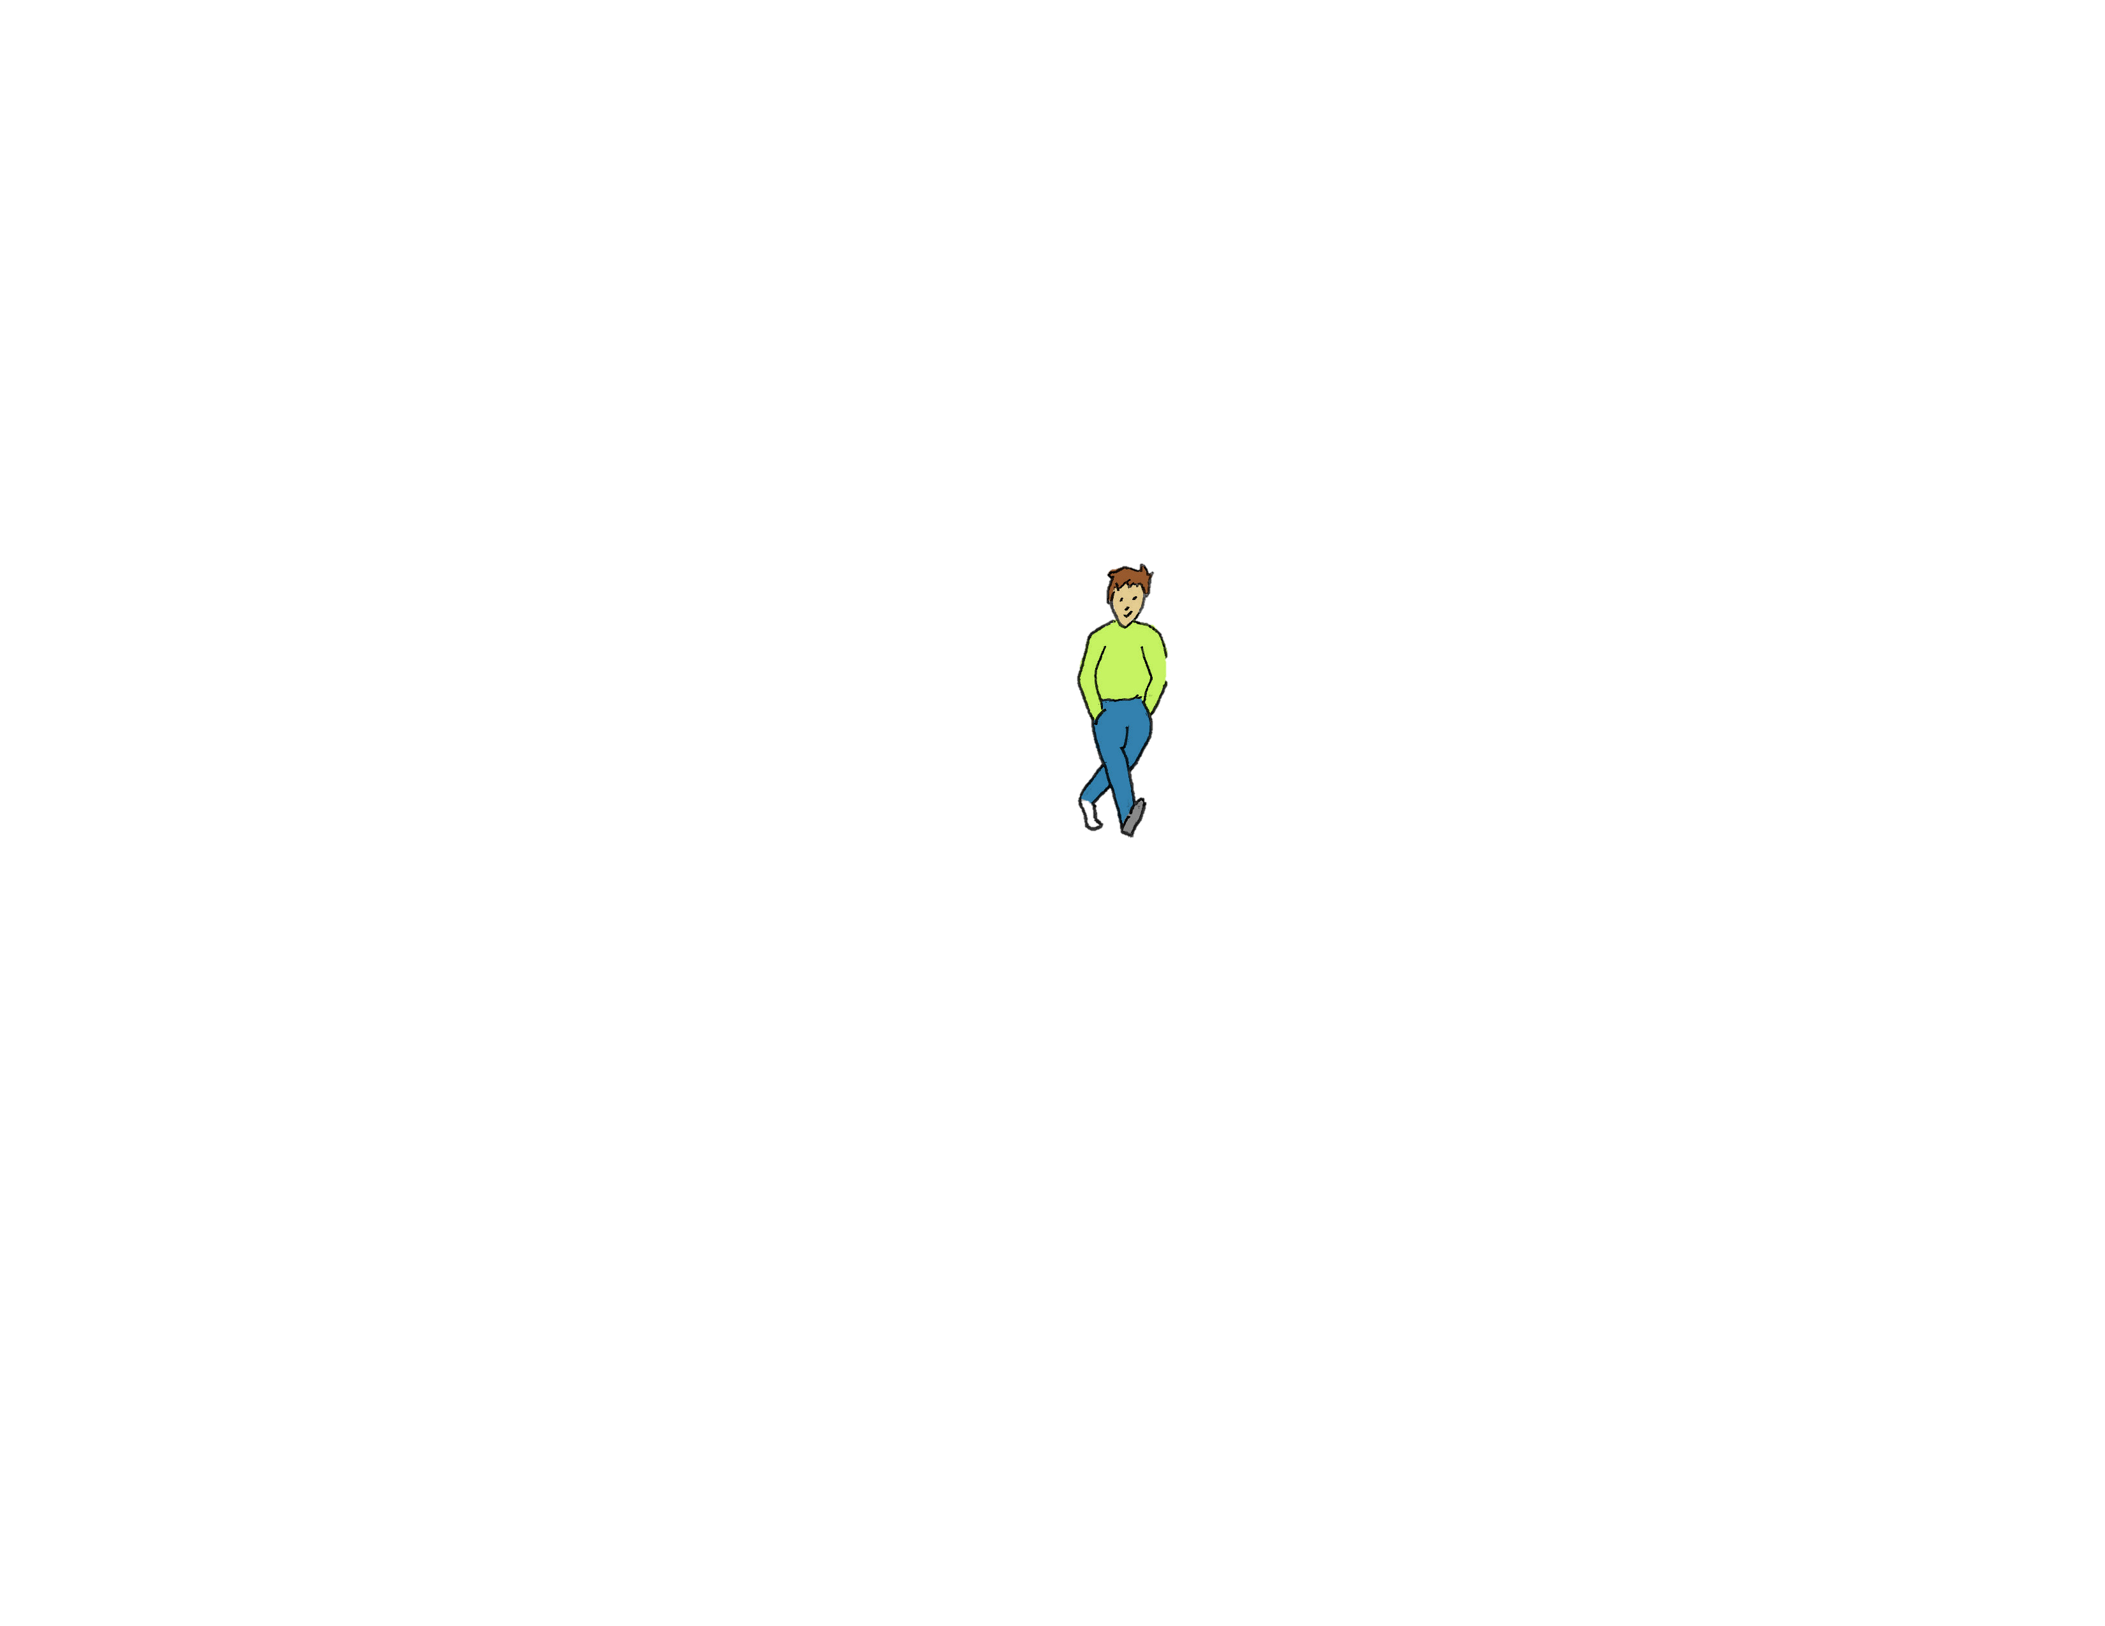
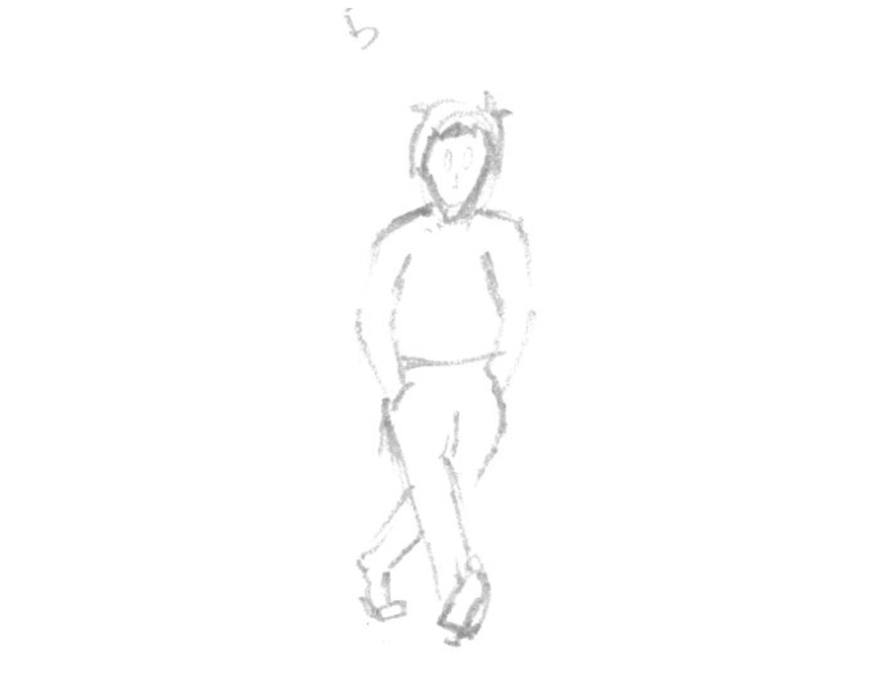
Notes:
Intro: More than we can sense
Our 5 senses – IR – UV – Magnetic Waves – WiFi – Cellphone

Slide 6

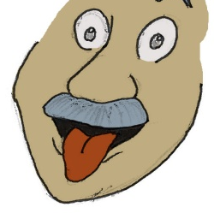

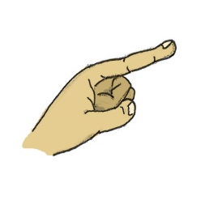
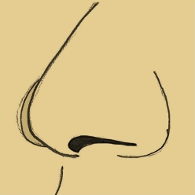
Notes:
Intro: More than we can sense
Our 5 senses – IR – UV – Magnetic Waves – WiFi – Cellphone

Slide 7
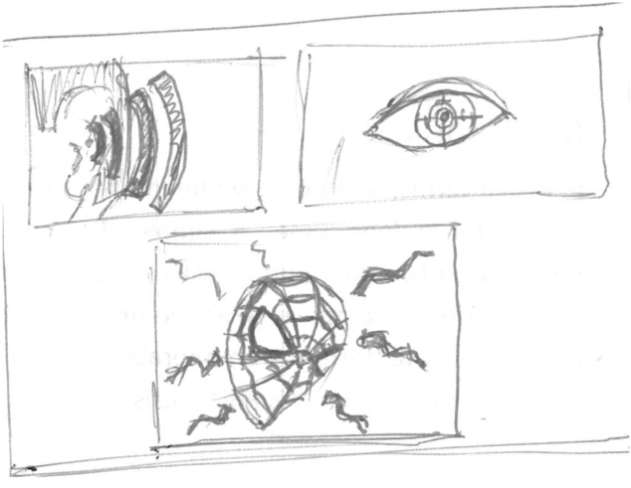
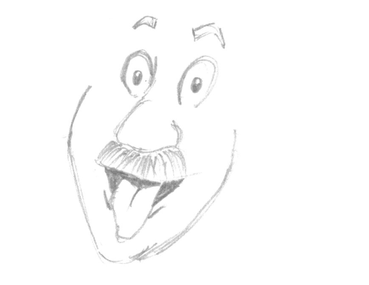
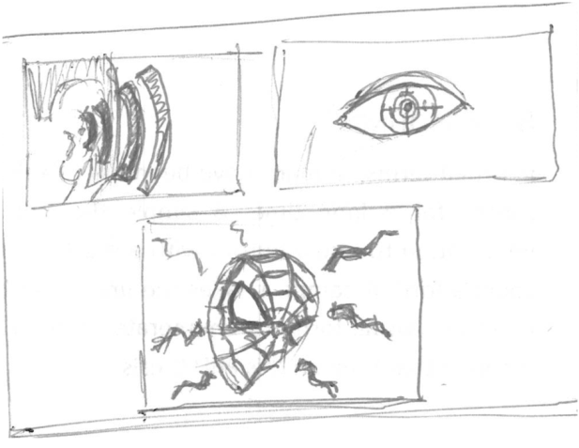
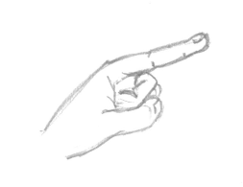
UV Light
IR radiation
Magnetic fields
Notes:
Intro: More than we can sense
Our 5 senses – IR – UV – Magnetic Waves – WiFi – Cellphone

Slide 8
UV Light
WiFi
IR radiation
RAdio
Magnetic fields
Pollution
Notes:
Intro: More than we can sense
Our 5 senses – IR – UV – Magnetic Waves – WiFi – Cellphone

Slide 9

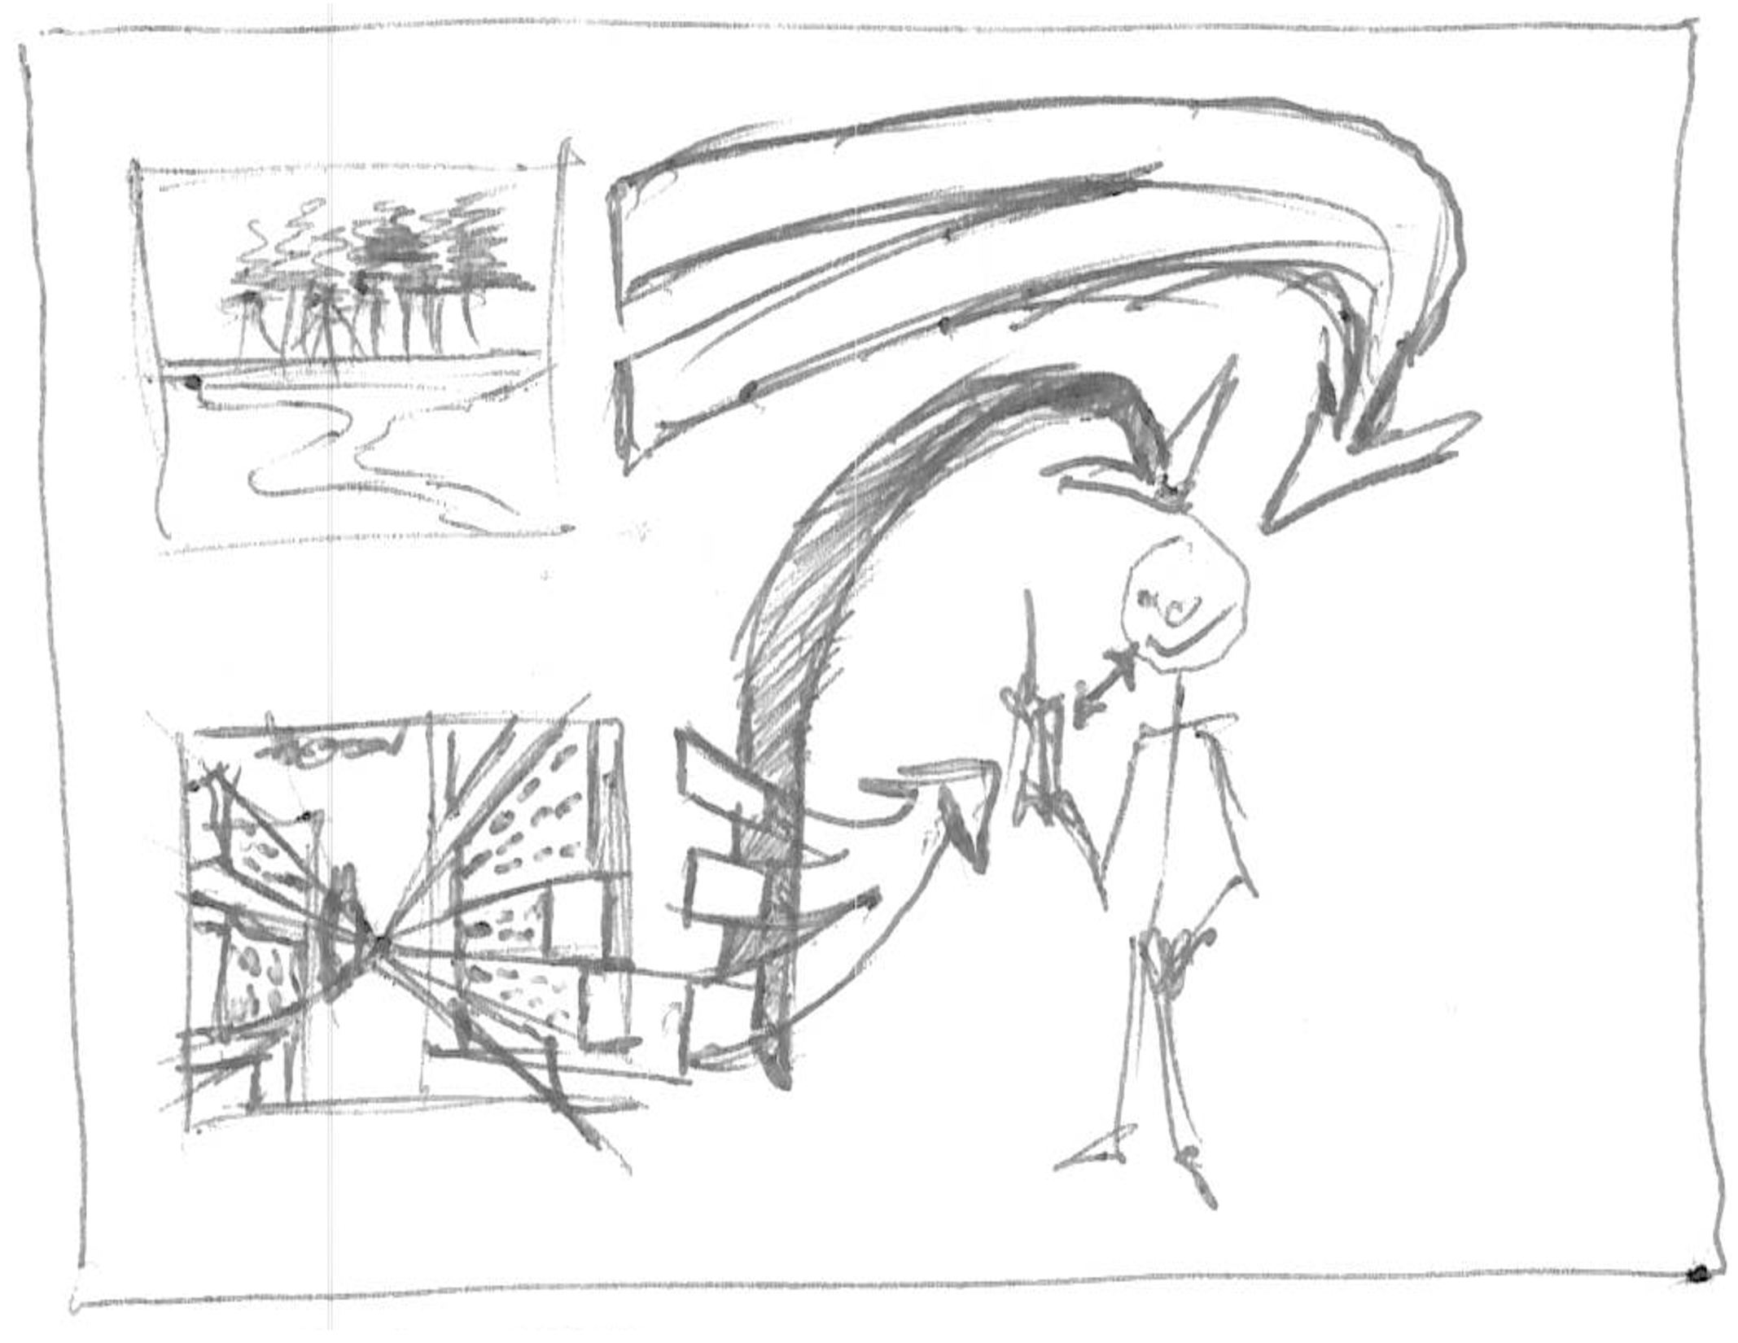
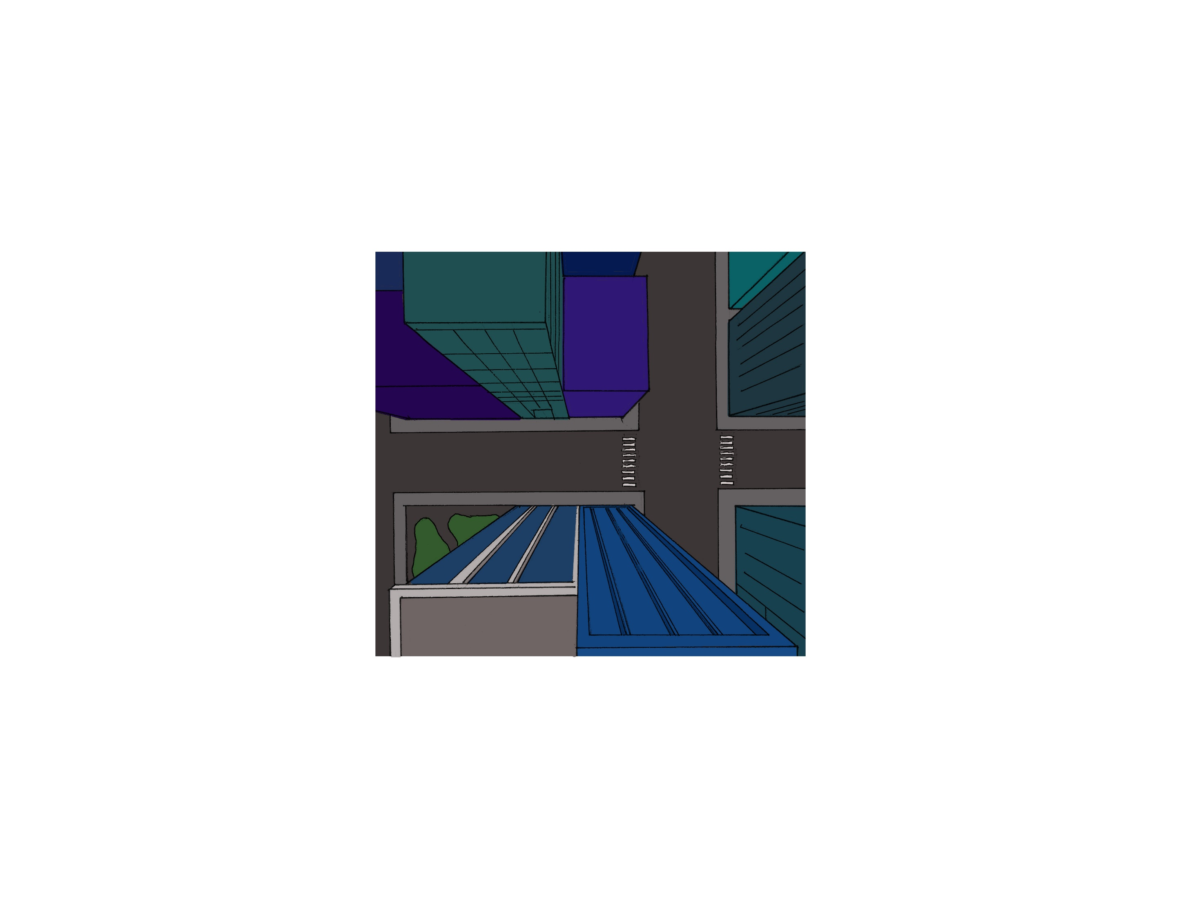
Nature signals
Mobile device translates
Human Made
Notes:
Intro: Mobile Device as translator
Some go to the user – Some go to the phone and then to the user.

Slide 10
UV Light
WiFi
IR radiation
RAdio
Magnetic fields
Pollution
Notes:
Why
All goes to vision
Vision demands too much attention

Slide 11
UV Light
WiFi
IR radiation
RAdio
Magnetic fields
Pollution
Notes:
Spread interaction across other senses
More natural experience
easier to divide attention

Slide 12
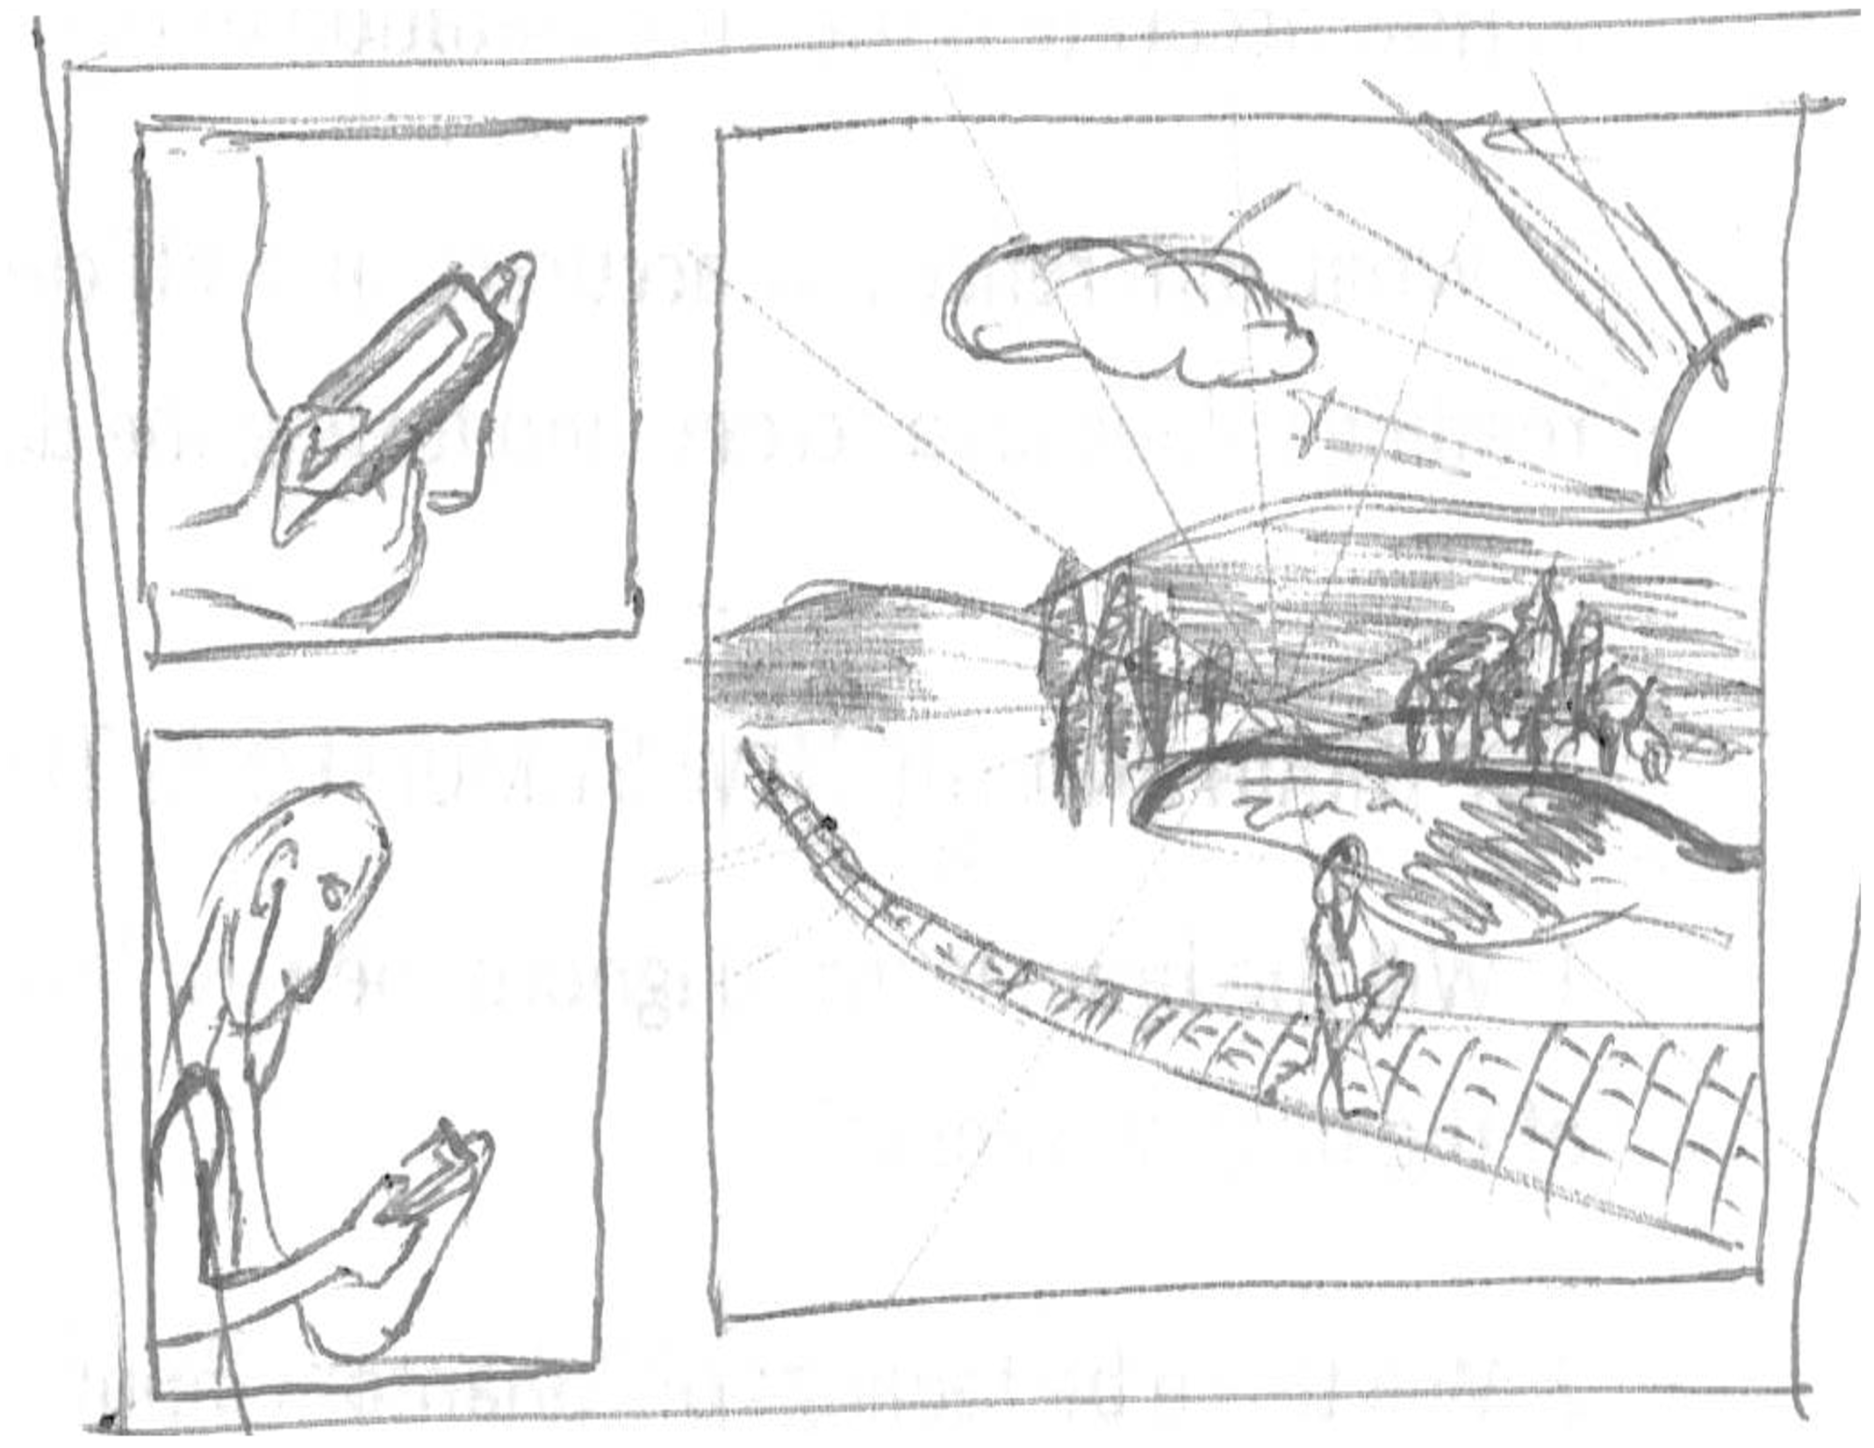


Mobile devices offer connection…
Digital synesthesia will create an immersive experience in the real world…
… and also distraction
… again!
Notes:
Intro Why!
Immersion in the real world

Slide 13
Background:
Thermal interfaces

Slide 14
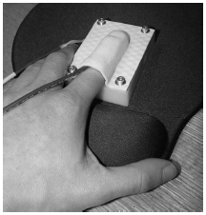
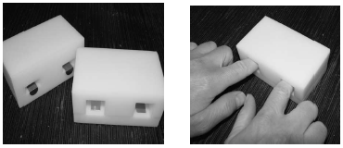
Different material are placed in the device
The pressure and temperature change of the finger was measured
The subject must identify the warmer and colder of the two
Development of thermal displays and understanding the nature of thermal cues.
“Material discrimination and thermal perception”
L. A. Jones and M. Berris
Notes:
Background: Thermal I
- Pressure on sample and relative temperature between finger an material are measured
- Two materials treated to have no recognizable textures would be inserted for the subject to identify the warmer from colder.

Slide 15
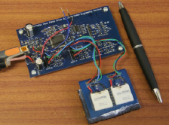
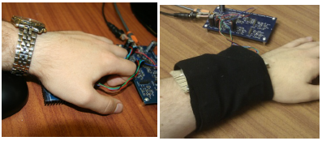
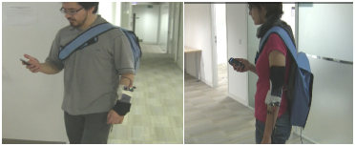
Microcontroller…
On the arm
… and Peltier
On the palm
users detect hot and cold stimuli presented to the fingertips, the palm and the arm
Two studies. One static indoor and one mobile
The experiment was repeated with the subjects walking around
“Some Like it Hot ? Thermal Feedback for Mobile Devices”
G. Wilson, M. Halvey, S. A. Brewster, and S. A. Hughes,
Notes:
Background: Thermal II
Static: Click the mouse when a change in thermal stimulation was felt. The temp of the peltier was recorded. Then rate the stimulus, “very hot” or “very cold” and “comfortable” and “very comfortable”.
Mobile: Wile walking.

Slide 16
Background:
Vibration interfaces

Slide 17
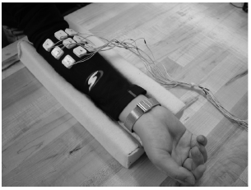
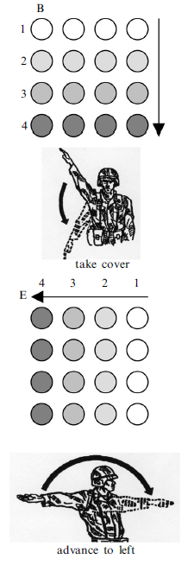
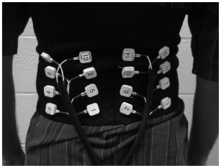
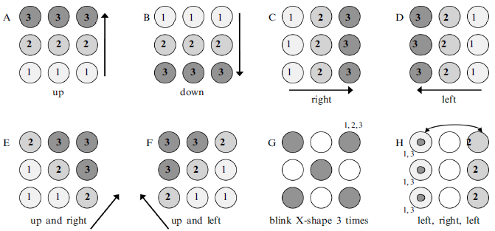
How a tactile display can communicate simple instructions and commands
On the arm
On the back
Simple patterns
Simple instructions
“Vibrotactile pattern recognition on the arm and back”
L. A. Jones, J. Kunkel, and E. Piateski
Notes:
Background: Vibration I
Participants would compare the vibration pattern with a cheat-sheet. Accuracy was different per pattern.
Compare patterns that signified hand and arm signals with the dots 98% and without 75%. Even when performing physical or cognitive tasks.

Slide 18
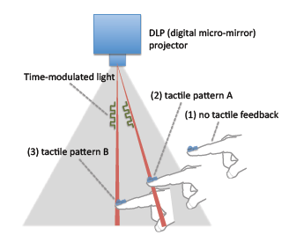
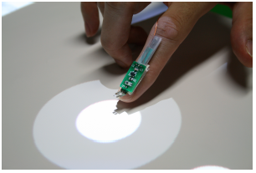
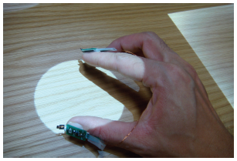
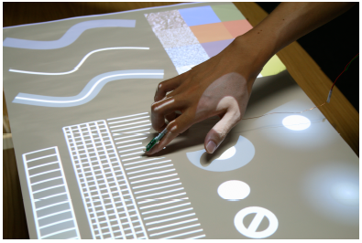
No need for positioning, the system detects structured light.
Full implementation of the system
Optical-haptic substitution
“SenseableRays: opto-haptic substitution for touch-enhanced interactive spaces”
J. Rekimoto
Notes:
Background: Vibration II
-Senseable Rays: Small and directly converts time-modulated light signals from a projector into haptic sensations.

Slide 19
Background:
Mobile device interfaces

Slide 20
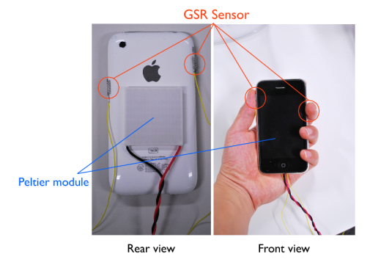
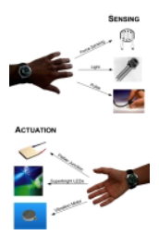
AffectPhone
Peltier delivers warmth or coolnes
detects a user’s emotional state using GSR, and conveys this state via changes in the temperature of the back panel of the other handset
Gsr sensor detects user’s emotions
“AffectPhone: A Handset Device to Present User’s Emotional State with Warmth/Coolness”
K. Iwasaki, T. Miyaki, and J. Rekimoto
connexus
Aims to detect various conditions at a time and transmit them in different ways
Detects Pressure, ambient light and heartbeat
Gives heat, light and vibration
““Connexus: a communal interface”
E. Paulos

Slide 21
Background:
Sensory Substitution

Slide 22
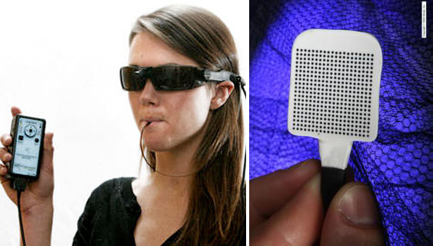
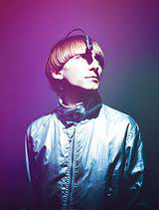
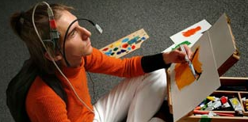
Brainport and eyeborg
Images captured by the camera…
… are translated to electrical signals in the tongue
“Brainport: an alternative input to the brain”
Y. Danilov and M. Tyler
Uses a color sensor and camera to translate…
… color information to sound
“Eyeborg”
Neil Harbisson
Notes:
Background: Sensory Substitution
-Barinport
-Eyeborg

Slide 23
Background:
New senses

Slide 24
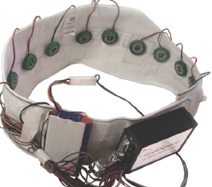




Feelspace belt, body hacking and momo
“feelSpace Belt”
Nagel, S. K., Carl, C., Kringe, T., Märtin, R., & König, P.
“Body Hacking: My Magnetic Implant”
D. Berg
“MOMO: a haptic navigation device”
C. WANG and K. O’FRIEL
Notes:
Baground: new Senses
FeelSpace Belt
Implanted magnets
Momo

Slide 25

Situational awareness
Take information from the environment, integrate it with previous knowledge and form a coherent mental picture
Notes:
Background: Interfaces
Situational Awareness

Slide 26
neuroplasticity
The ability of the brain to assimilate new input
Notes:
Background: Interfaces
Situational Awareness

Slide 27
Digital Synesthesia

Slide 28



Skin’s light sensitivity to find a tall grass
Sense victim through smell
Jump and hopefully land on animal
The tick understands only three signs
Smell
Temperature
hairiness
Find bald spot and feast
“a foray into the Worlds of Animals and humans”
Jakob von Uexküll
Notes:
Digital synesthesia
Semantic sensory theory
Sensory data as signs
umwelt as the perceptual world in which an organism exists and acts as a subject

Slide 29


Bees can use uv light to pick flowers
Hammer-head sharks hunt sensing electric signals from the muscles of prey
Notes:
Nth Sense:
The things we could do if we could sense new information?
How would our world perception change?

Slide 30

Bees can use uv light to pick flowers
Hammer-head sharks hunt sensing electric signals from the muscles of prey
Notes:
Nth Sense:
The things we could do if we could sense new information?
How would our world perception change?

Slide 31

Cognitive load
When by-passing the visual sense, it is easier for the brain to interpret information without shifting attention from current task
Notes:
Background: Interfaces
Situational Awareness

Slide 32



We all feel the same conditions in a different way

Slide 33
Research plan
Stage i:
Compare natural and artificial senses
Stage ii:
New senses in a known context
Stage iii:
New senses with unknown context
Stage iv:
Generalizing projections of synesthetic design

Slide 34

Research plan, stage i
A glove with a pressure sensor…
… on the tip of the ring finger
The user will hold a tray and locate various objects on it
The task is to organize the objects according to weight

Slide 35
Research questions, stage i
Discreet or continuous?
Does the user find discreet signals better than a continous changing signal?
Does this depend on the experience?
Sense augmentation?
Is there a benefit of the artificial sense over the natural sense when used together?
Sense substitution?
Can this artificial sense replace an existing sense for the given activity?
New stimuli?
How accurate is the digital sense in comparison to the natural sense?

Slide 36





Research plan, stage ii
Head Band
Outward IR sensors on the forehead
Inward transducers
Set up a group activity
User will have an advantage
Detecting the stress level of the others

Slide 37
Research questions, stage ii
New senses?
How does the user perform when having access to a new sense?
New stimuli?
How accurate is the digital sense in the context?
Sense substitution?
Can this artificial sense replace an existing sense for the given activity?
Is there a phantom sense feeling?
Is there a difference depending on the user’s familiarity with the task?

Slide 38


Research plan, stage iii
Neck
Peltier device responds to location…
With the glass infrastructure
Interact with the lab
Use doppellab to interact with the user

Slide 39
Research questions, stage iii
Human development?
When learning a new sense, are children better at it than adults?
New stimuli?
How fast to users understand the new stimuli?
Does it depend on the activity or the feedback?

Slide 40


Research plan, stage iv
Design thinking
… tree
From Sapling…

Slide 41
Research questions, stage iv
Escaping the visual interface?
Can this artificial sense replace an existing sense for the given activity?
Design thinking?
Can a pattern be identified to generalize a digital synesthesia design process?

Slide 42
timeline
PHASE ONE (JANUARY - march)
This stage is dealing with the final contexts that will be developed to prove my thesis as well as getting the proposal submitted and approved by MASCOM and defended.
This is the development stage. Fabrication and initial testing of the devices
PHASE TWO (march - APRIL)
Final testing will be made of each of the systems for the contexts chosen. Extra attention will be put on the mobility of the system and its future deployment outside the lab. User testing on the first stage will begin.
PHASE THREE (MAY - JUNE)
User Testing will be done for the second and third stages.
PHASE FOUR (JULY - AUGUST)
Thesis writing and defense.

Slide 43
conclusions
Escaping the visual interface?
Can this artificial sense replace an existing sense for the given activity?
Design thinking?
Can a pattern be identified to generalize a digital synesthesia design process?

Slide 44
The end
Thank you…
Questions?

